Slide 1

OVERCOMING BARRIERS TO HEALTH OUTCOMES IN
HUMANITARIAN CRISES: WHAT ROLE CAN CASH AND
VOUCHER ASSISTANCE PLAY? THE RESPONSE OPTIONS
ANALYSIS TOOL
JULY 2022
GLOBAL HEALTH CLUSTER – CASH TASK TEAM

Slide 2


Slide 3

OUTLINE OF PRESENTATION
• Review of the Tanahasi barriers framework
• Introduce the response option analysis tool
• Outline different interventions related to barriers to health
outcomes using the same framework
• Different CVA related modalities to address barriers to health

Slide 4

WHAT DOES THE RESPONSE OPTIONS GUIDANCE ANALAYIS NOTE
DO?
Brings together all the relevant health/CVA concepts
and frameworks & shares tools:
1. Purpose and target audience
2. Scope of the guidance
3. Using the Tanahashi barriers framework
4. Understanding health expenditures and
financial barriers
5. Response Option Analysis: Interventions to
address the barriers – including CVA
5.1 Overview of Response Options, including
● Links the Tanahashi Barriers Analysis division of demand
and supply side interventions
● Explains health expenditures and financial barriers
● Provides common examples of interventions that can be ^{CVA for health}
used to address each barrier
5.2 Selecting the appropriate CVA modality:
6. Assessments and Indicators
● Provides examples of the appropriate use of CVA
6.1 Assessing barriers to health services
6.2 Health & CVA Indicators, linked with the
assessment/monitoring tools
7. Monitoring indicators for implementing CVA
modalities
amongst these interventions
● Shares tools for assessment & monitoring
● Shares indicators to monitor

Slide 5
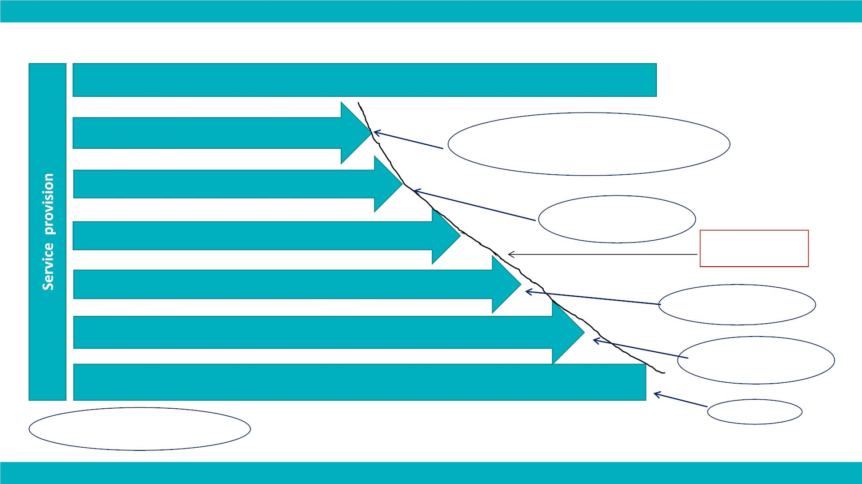
BARIERS TO HEALTH - USING TANAHASHI FRAMEWORK
Service Delivery Goal (ensuring the right to health for all)
Effective Coverage
(people who receive services of sufficient quality)
Referrals
Quality assurance
Adherence to
treatments
Access to medicines
Contact Coverage
(people who actually use the health services)
Equity of utilisation
Acceptability Coverage
(people who are willing to use the health services)
Financial protection
Coverage
curve
Accessibility Coverage
(people who are able to use the health services)
Financial barriers to care
Availability Coverage
(people for whom health services are available)
Leveraging public &
private health service
capacity
People of Concern
(the target population)
Factors potentially
addressed by different CVA
modalities
Targeting

Slide 6

UNDERSTANDING HEALTH EXPENDITURES
Financial Barriers
Direct
cost
Indirect
costs

Slide 7
RESPONSE OPTION ANALYSIS TOOL: INTERVENTIONS TO
ADDRESS THE BARRIERS
● Determining the appropriate response
● Interventions to address availability and accessibility of services
● Interventions to reduce financial barriers for both direct and
indirect costs
● Potential CVA interventions and modalities alongside other
health interventions.

Slide 8

INTERVENTIONS REALTED TO AVAILABILITY
DEMAND
SUPPLY
Interventions to address barriers
related to availability of health
services
Interventions to address barriers
related to availability of health
services
Are
services
available?
• Restore functionality of health
facilities
• Ensure adequate ratio of facilities
against target population
• Information campaigns of
availability of services
• CVA programs for health
services can indirectly
increase service capacity
when demand increases
• Ensure optimal location of facilities
for the majority of the population
• Ensure availability of a package of
priority health services
• Establish temporary health facilities,
and or mobile clinics

Slide 9

INTERVENTIONS RELATED TO ACCESSABILITY
DEMAND
SUPPLY
Interventions to address
protection
Interventions to address
protection of health care
• Improve security in and around
health services within the
community
• Improve security in and around
health services
Protect people without proper legal status
•
Interventions to address
physical barriers
Are
services
accessible
?
Interventions to address physical
and organizational barriers
• Informational campaigns on
• Ensure physical access for
disabled and the elderly
• Increase opening hours
services and accessing them
Interventions to address issues of
discrimination and exclusion
Interventions to address physical
and organizational barriers
• Improve social cohesion
• Ensure registration and or
administrative access of IDP’s and
refugees
• Address discriminatory attitudes
and policies by providers

Slide 10

INTERVENTIONS RELATED TO AFFORDABILITY
DEMAND
SUPPLY
Interventions to address financial
barriers
Interventions to address financial
barriers
Are
services
affordable
?
• Vouchers for direct health care
costs of selected services
• Cash for transportation or other
indirect costs
• Reduce reliance on user fees through
public funding, or pooling of fund
• Create health insurance coverage for
the most vulnerable
• CVA for health-related
commodities
• Contracting and purchasing of services
• Health Equity Fund
• Health Equity Funds
• MPC for opportunity cost and or
to meet basic needs
• Financial protection for the most
vulnerable; exemptions to pay user fees
• Incentives, hardship allowance for
health work-force

Slide 11

INTERVENTIONS REALTED TO ACCESSABILITY
DEMAND
SUPPLY
Interventions to address socio-
cultural barriers
Interventions to address socio-cultural
barriers
Are
services
acceptable
?
• Address health seeking behavior
• Awareness campaigns on health
services and quality
• Set up complaint mechanisms
• Patient – community representation
in health committees
• CVA for health has the potential to
indirectly impact socio-cultural
barriers when cost/financial barriers
are removed
• Train health workers on culturally and
gender sensitive care
• Ensure adequate number of female staff
• Ensure privacy and confidentiality of
services
• Provide services in the appropriate
language
• Set up independent complain mechanisms
• Integrate health services with traditional
health systems

Slide 12

INTERVENTIONS RELATED TO UTILIZATION
DEMAND
SUPPLY
Interventions to address utilization
Interventions to address utilization
Are
services
used?
• Address health seeking behavior
• Awareness campaigns on health
services and quality
• Set up complaint mechanisms
• Patient – community
representation in health
committees
• CVA for health has the potential
to indirectly impact socio-cultural
barriers when cost/financial
barriers are removed
• Train health workers on culturally
and gender sensitive care
• Ensure adequate number of female
staff
• Ensure privacy and confidentiality of
services
• Provide services in the appropriate
language
• Set up independent complain
mechanisms
• Integrate health services with
traditional health systems

Slide 13

INTERVENTIONS RELATED TO EFFECTIVE COVERAGE
DEMAND
SUPPLY
Interventions to address quality of
services
Interventions to address quality of
services
Are
services
effective
and of good
quality?
•
•
Community support for adherence to treatment
Set up complaint mechanism
• CVA for health commodities
linked with health promotion
• Vouchers that include quality
standards in the contract with
the provider
• Cash for referral transport
• Cash for other increased costs
linked with diagnosis/treatment
• Improve referral pathways
• Increase staff and patient safety
• Training in adherence to
treatment protocols, and
communicating with patients on
treatments
• Quality improvement
processes

Slide 14

HOW CAN CVA FOR HEALTH SUPPORT HEALTH OUTCOMES?
DIRECT EFFECTS
INDIRECT EFFECTS
• Reduce financial barriers
• Reduce financial barriers
• Ensure quality medicines
• Access to health goods
• Ensure quality medicines
• Access to health goods
• Incentive utilization of
• Incentive utilization of
services (vouchers)
services (vouchers)

Slide 15

SELECTING THE
APPROPRIATE
CVA MODALITY

Slide 16
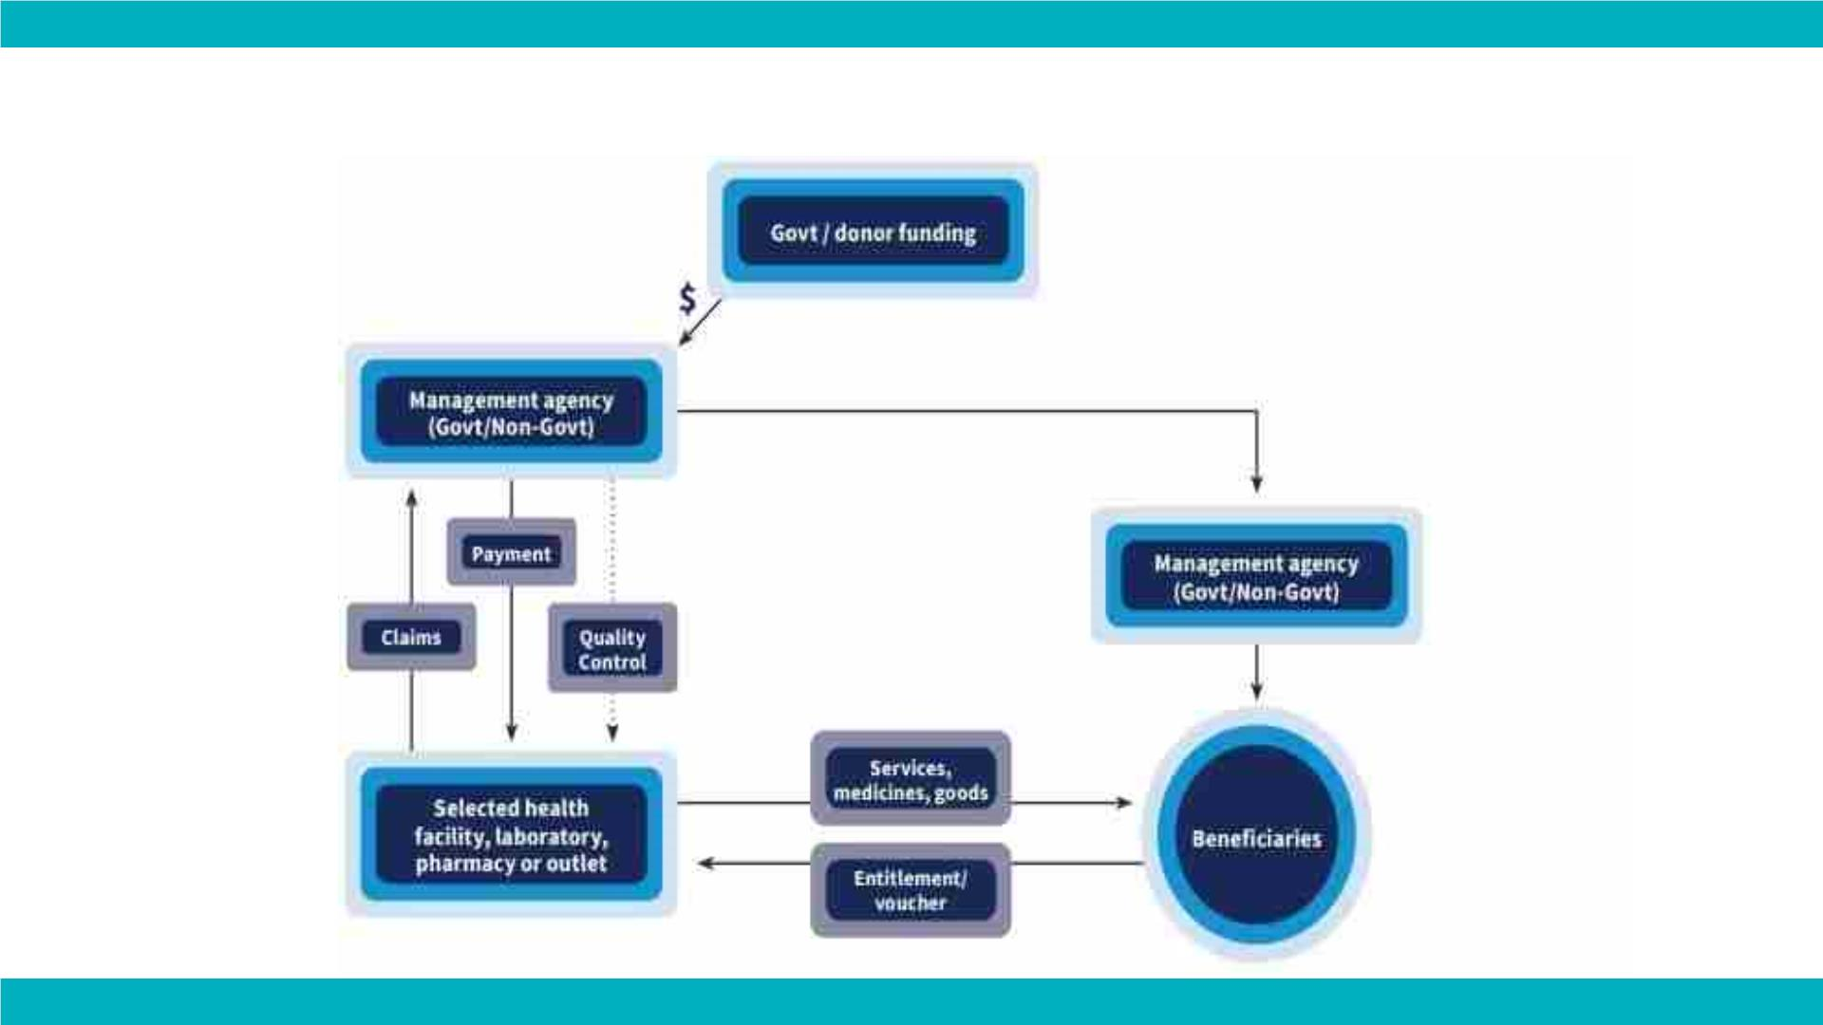
VOUCHERS & HEALTH EQUITY FUNDS
-

Slide 17

PROS & CONS OF VOUCHER & HEALTH EQUITY FUNDS
PROS
CONS
• Ensure the quality of the
• Takes time to set up
care received
• Reduce risk of beneficiaries
paying higher costs for
services
• positive effect on the
capacity of services

Slide 18
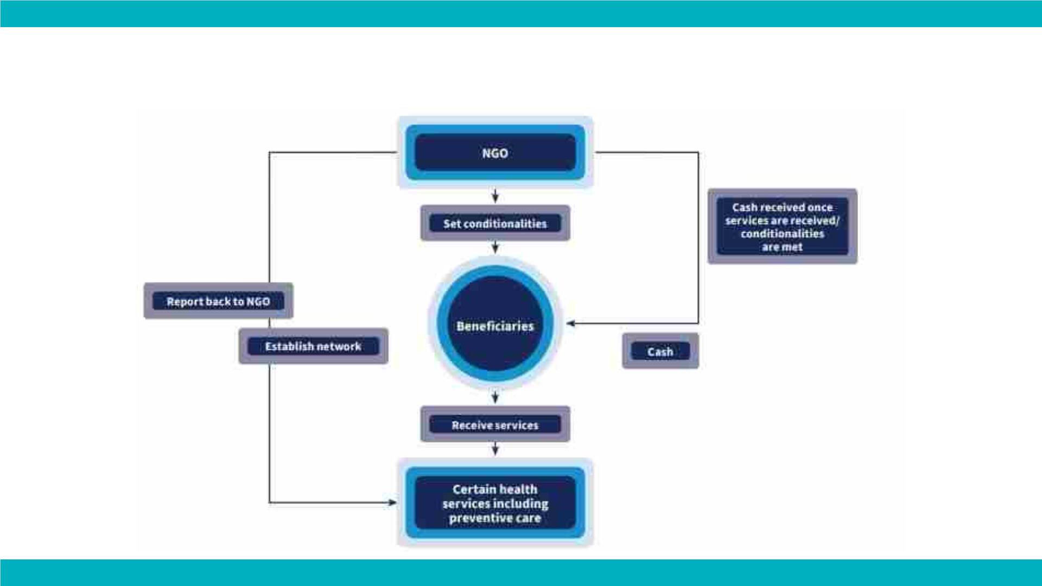
CONDITIONAL CASH FOR HEALTH OUTCOMES

Slide 19

PROS & CONS OF CONDITIONAL CASH
PROS
CONS
• Increase coverage of
and/or adherence to the
programs
• Monitoring can be time-
consuming
• Conditionality may not be
met due to factors beyond
the control of the patient –
however this can be
• Behavioral change
addressed during the
assessment phase

Slide 20
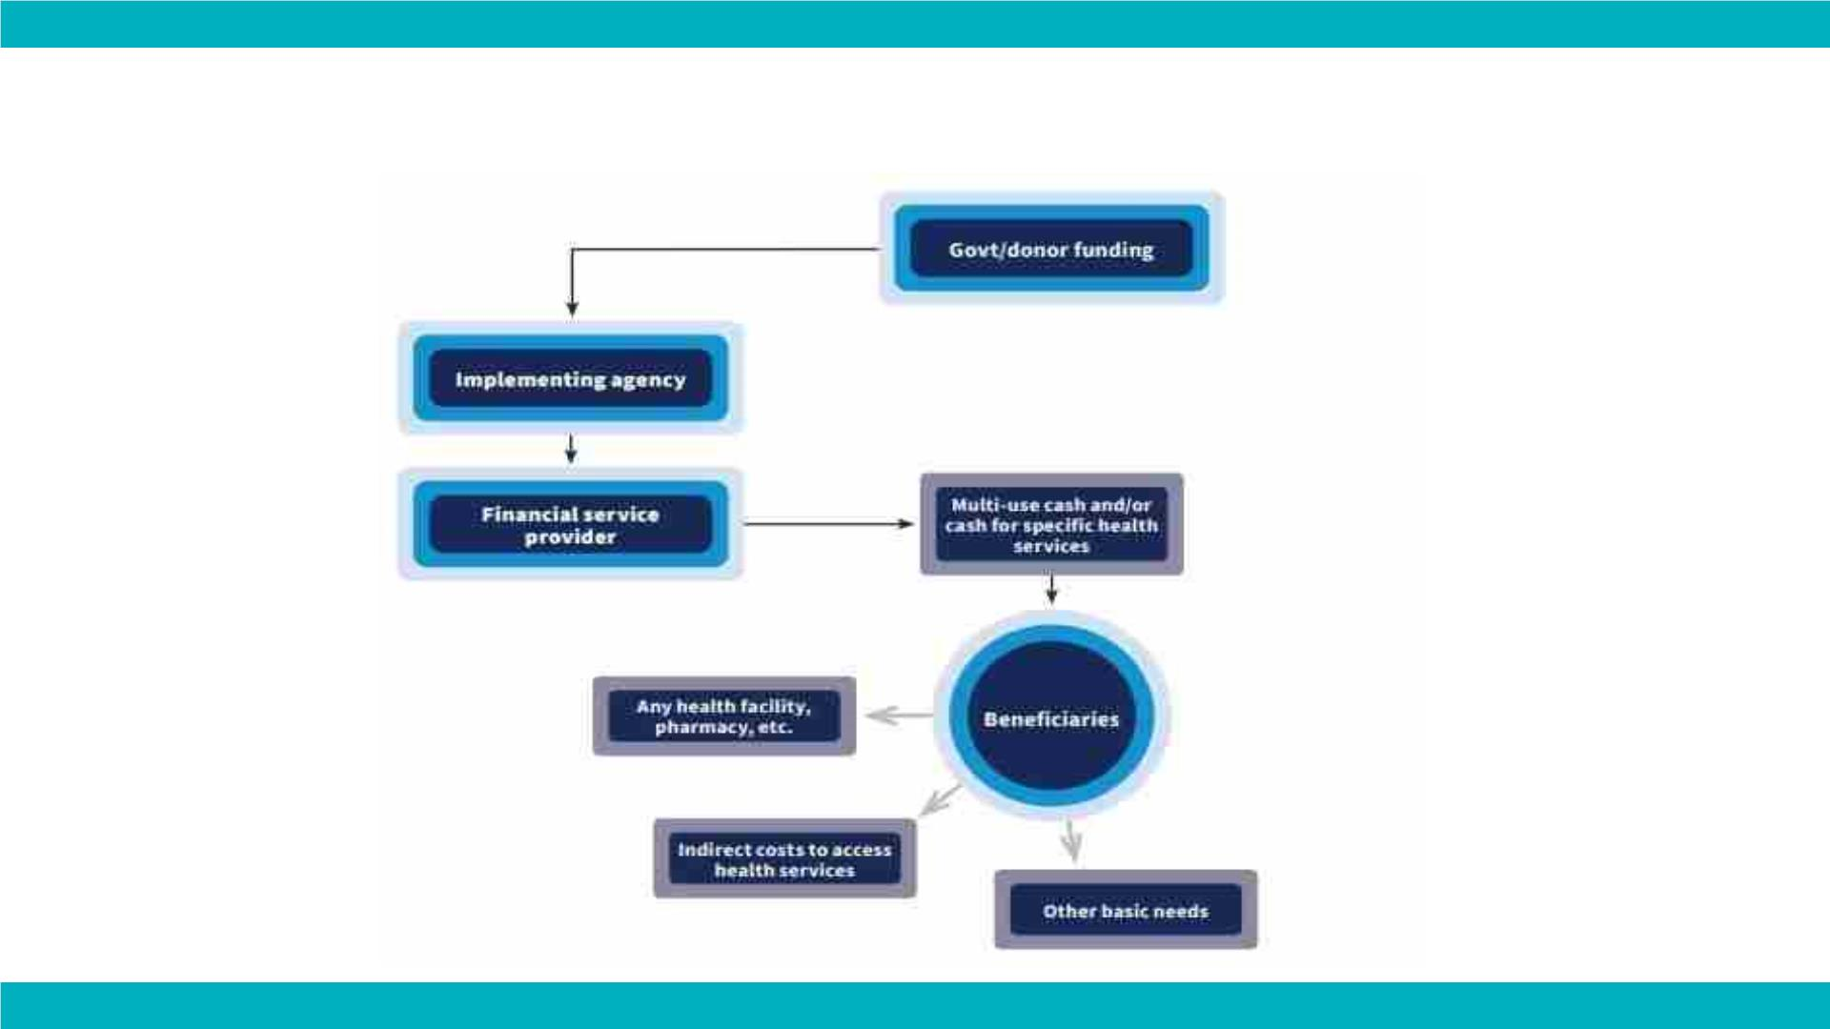
UNCONDITIONAL CASH FOR HEALTH OUTCOMES

Slide 21

PROS & CONS OF UNCONDITIONAL CASH
PROS
CONS
• Cash linked to specific
• Quality cannot be ensured
health need
• May prioritize other needs
if not linked with other
interventions
• Address financial
barriers

Slide 22

HOW CAN CVA FOR HEALTH SUPPORT HEALTH OUTCOMES?
DIRECT EFFECTS
INDIRECT EFFECTS
• Reduce financial barriers
• Increase availability and
capacity of services
• Ensure quality medicines
• Access to health goods
• Ensure quality and
effectiveness of treatment
• Incentive utilization of
• When given as MPC can
contribute to better health
outcomes
services (vouchers)

Slide 23

WHERE CAN YOU FIND OUT MORE?
CALP has a series of webinars on cash and voucher assistance and health.
Sign up to our newsletters, follow us on YouTube or other channels to find
out more.

Slide 24

THANK YOU
for listening

Slide 25

www.calpnetwork.org

Slide 26


