Slide 1
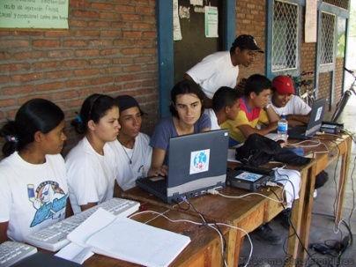
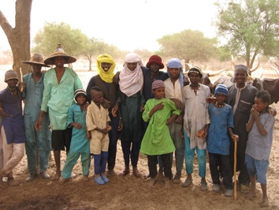
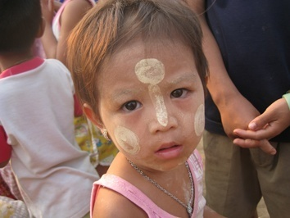
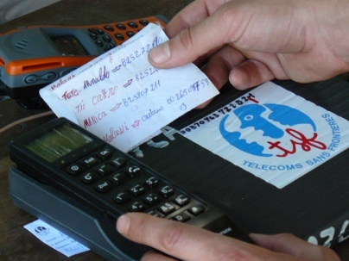
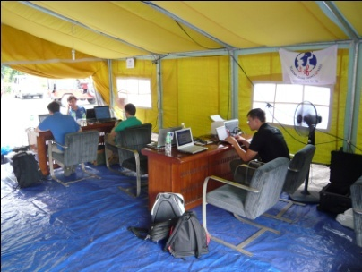
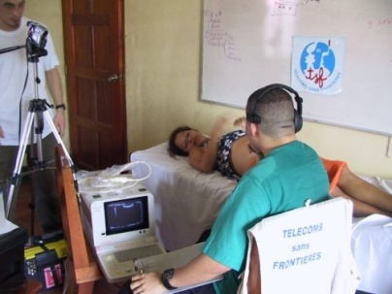
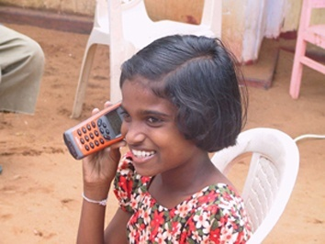
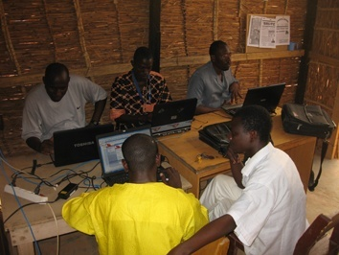
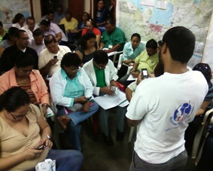
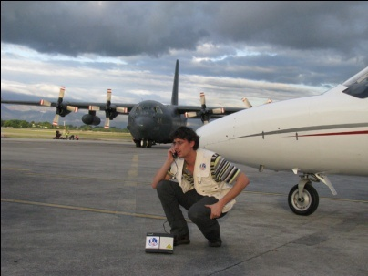
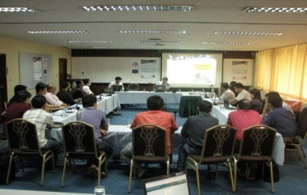
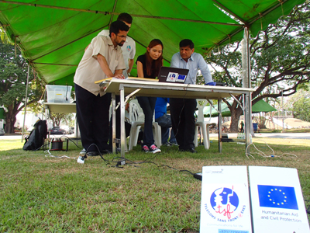
Mobile Network Innovation in a Backpack
Télécoms Sans Frontières
Communications for life
Notes:
1
1

Slide 2
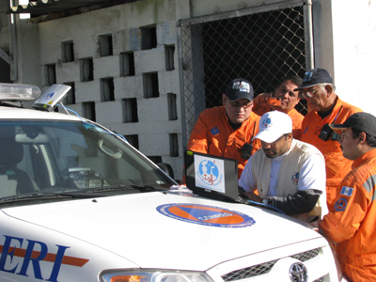
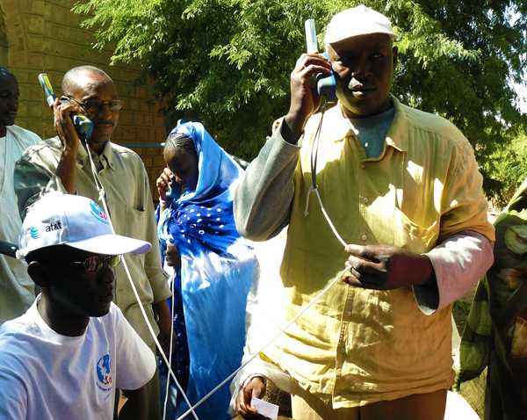
THE LEADING NGO
IN EMERGENCY TELECOMMUNICATIONS
Télécoms Sans Frontières
TSF created in 1998
The world’s leading emergency
telecommunications non-profit organisation
3 DEPLOYMENT BASES
Latin America/Caribbean - Europe – Asia/Pacific
A REPRESENTATION IN WASHINGTON DC
Restoring family links in Timbuktu, Mali, 2013
Supporting aid agencies in Guatemala, 2012
Ready to deploy anytime anywhere in the world 24/7
Notes:
2

Slide 3
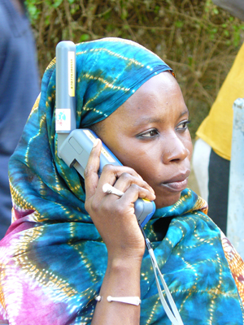
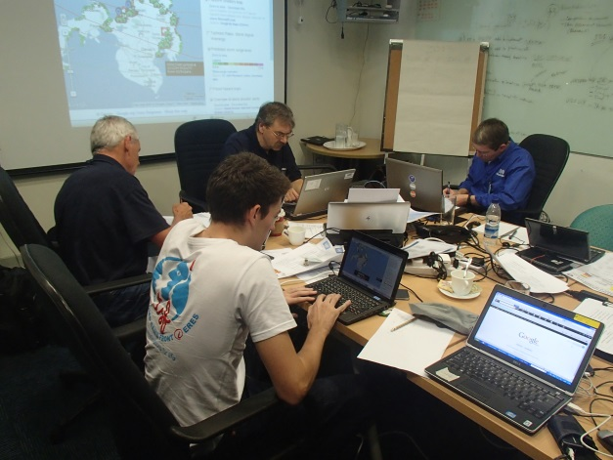
A UNIQUE POSITION
IN EMERGENCY TELECOMMUNICATIONS
Télécoms Sans Frontières
Our Core Activities
- Rapid response telecommunications centres
Humanitarian calling operations (HCO) – free calls for civilians
Building local capacity for disaster preparedness
- Bridging the digital divide with long-term community centers
Emergency ICT training, Bangkok, 2013
HCO, Timbuktu, 2013
UNDAC support, Philippines , 2012
Notes:
3

Slide 4
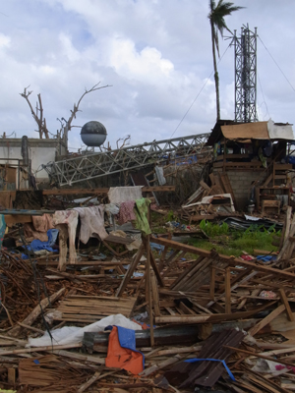
TECHNOLOGY
Mobile network in a backpack
Vodafone Foundation Instant Network Mini
Télécoms Sans Frontières
GSM connectivity in 2014
Development projects for communities
GSM networks:
are very efficient for development projects;
can allow local economies to grow;
provide diverse and rich services & features.
Substantive economic leverage
Growing telecommunication industry investment
in Cash Transfer solutions;
The most reliable telecommunication service;
Mobile phones keep families linked
Notes:
4

Slide 5
TECHNOLOGY
Mobile network in a backpack
Vodafone Foundation Instant Network Mini
Télécoms Sans Frontières
Geographical weaknesses
A lot of locations are still isolated and out of GSM coverage for various reasons:
Local providers’ interests;
Energy sources;
Mainly farmers and small communities, mostly exposed to lack of facilities;
Relief staff and logistics for alternative solutions
Interesting areas
Where emergency and critical care services are provided;
Where veterinary relief campaigns are in progress;
Where data collection is planned;
In market places in isolated communities to facilitate financial transfers;
… further areas can be discussed.
Notes:
5

Slide 6
TECHNOLOGY
Mobile network in a backpack
Vodafone Foundation Instant Network Mini
Télécoms Sans Frontières
What is it for?
Opening up the isolated communities and nomadic populations depending on the season;
Supporting any services over GSM to the benefit of the most vulnerable communities such as SMS exchanges, Cash-Transfer, Data-Gathering, Data diffusion…
Being adapted to any relief organization by providing a deployable solution in 10 minutes without requiring any technical profile;
Well suited for emergency situations.
Notes:
6

Slide 7
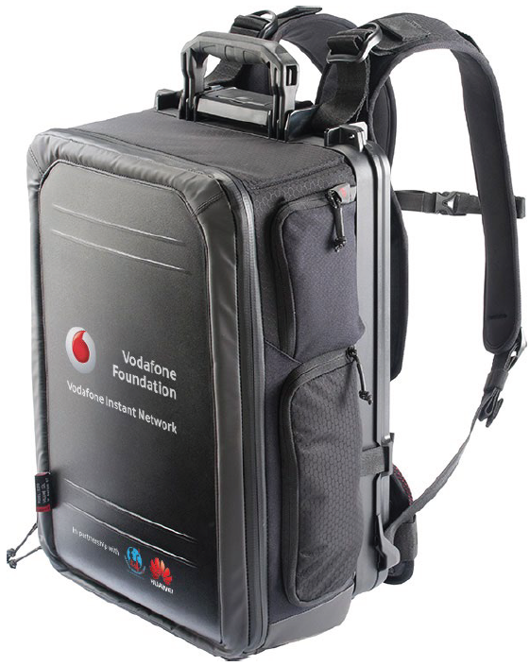
TECHNOLOGY
Mobile network in a backpack
Vodafone Foundation Instant Network Mini
Télécoms Sans Frontières
Technical features
Transportable as hand luggage (IATA compliant);
Weight of 11 kg in a backpack;
Multiple power sources: internal battery, internal solar panel, external power sources;
Provides GSM coverage for a 100 metre radius;
Supports charging up to 3 mobile phones at a time;
Notes:
7

Slide 8
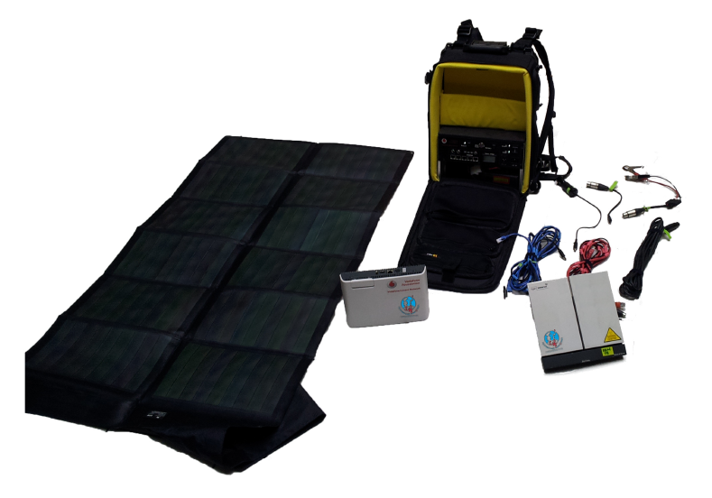
TECHNOLOGY
Mobile network in a backpack
Vodafone Foundation Instant Network Mini
Télécoms Sans Frontières
Internal components
Internal Battery
High capacity (11,000 mAh)
Solar panel
Nominal power: 62 Watts
GSM Cell
Huawei Mini BTS
Satellite modem
Inmarsat BGAN 500
Notes:
8

Slide 9
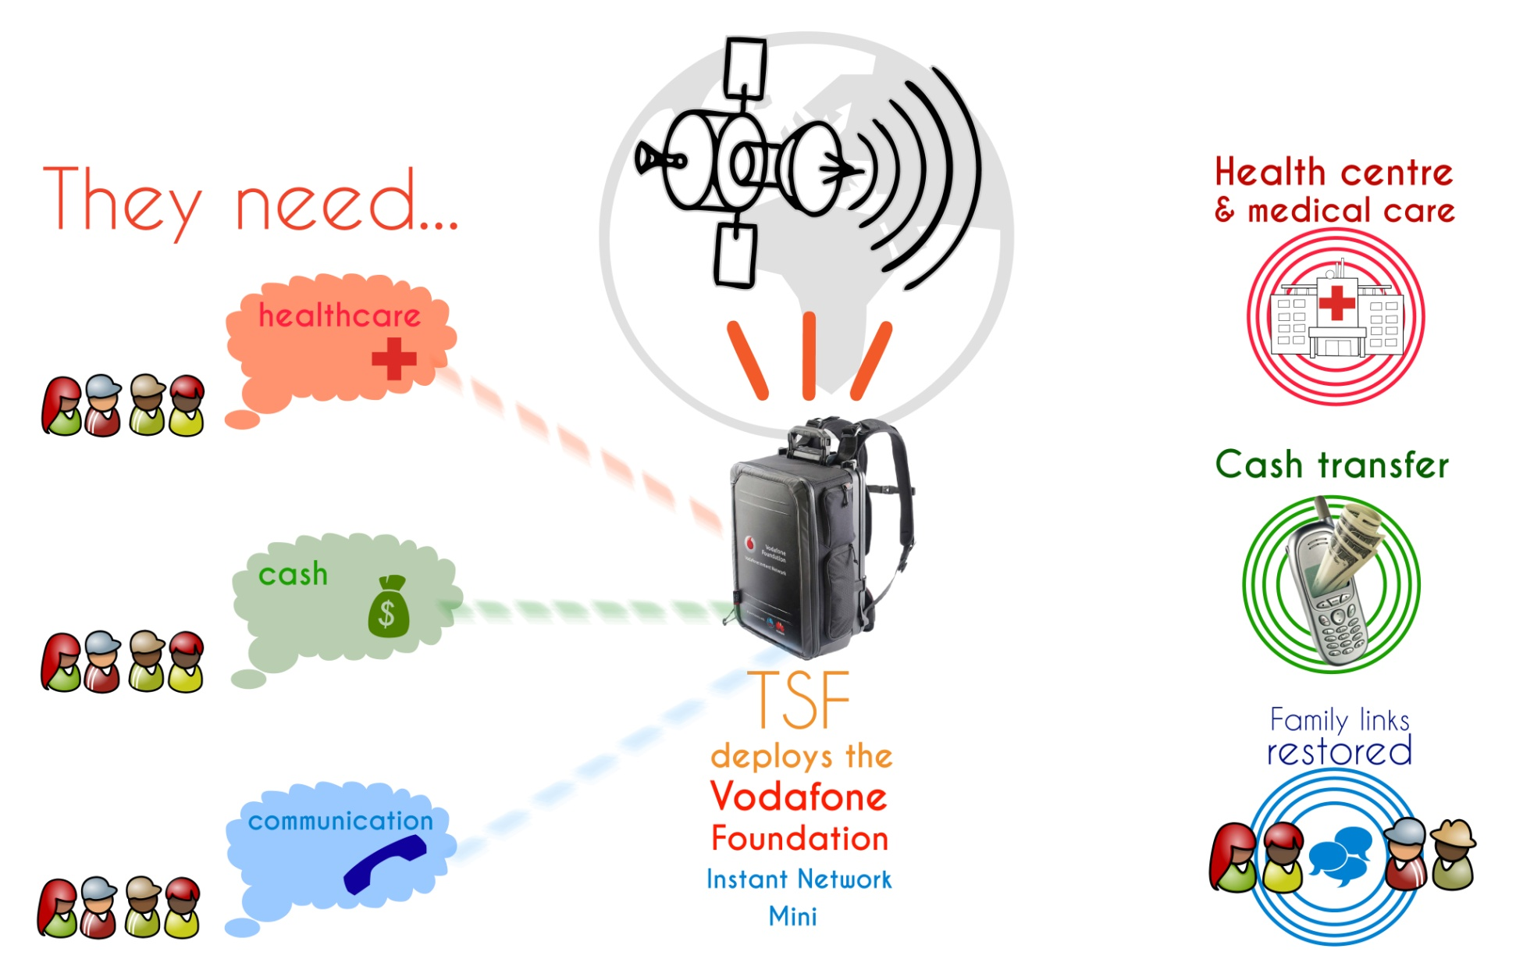
TECHNOLOGY
Mobile network in a backpack
Vodafone Foundation Instant Network Mini
Télécoms Sans Frontières
Notes:
9

Slide 10
TECHNOLOGY
Mobile network in a backpack
Vodafone Foundation Instant Network Mini
Télécoms Sans Frontières
What is the next step?
The technology has been developed, tested and validated at the TSF HQ in France in partnership with Vodafone Foundation;
For testing purposes, TSF needs to deploy the solution in the field for two weeks to validate the following steps:
GSM providers requirements to reach its GSM network;
Assess the field needs and how people handle this technology;
Power self-sufficiency in the field (solar panels, external batteries, …).
TSF has to identify isolated areas interested by this technology.
The most reliable actors in the field are organizations already working there
Notes:
10

Slide 11
TECHNOLOGY
Mobile network in a backpack
Vodafone Foundation Instant Network Mini
Télécoms Sans Frontières
Country compatibility
TSF needs a close relationship with the local provider. Because the development was carried out alongside the Vodafone Foundation, the knowledge they have is a strong advantage for setting up this technology.
Country | GSM provider
Congo | Vodacom
Kenya | Safaricom
Ghana | Vodafone
Tanzania | Vodacom
South Africa | Vodacom
Notes:
11

Slide 12
TECHNOLOGY
Mobile network in a backpack
Vodafone Foundation Instant Network Mini
Télécoms Sans Frontières
Activity compatibility
A lot of activity domains are able to benefit from this innovative technology. This list should grow on field organizations’ suggestions:
Activities
Medical and veterinary care
Cash Transfer
Data collection
Data diffusion
Communication via SMS
Notes:
12

Slide 13
TECHNOLOGY
Mobile network in a backpack
Vodafone Foundation Instant Network Mini
Télécoms Sans Frontières
Cost requirements
All costs related to the technology tests will be taken care of by TSF, including additional logistic costs.
The advantage of working with locally deployed organizations is being able to benefit from their field knowledge and logistics that are already in place. No additional costs would be required from them.
Integration of mobile technology into current projects could make data reporting easier during the solution’s test activities for two weeks.
Notes:
13

Slide 14
TECHNOLOGY
Mobile network in a backpack
Vodafone Foundation Instant Network Mini
Télécoms Sans Frontières
Planning
The “test project” would be two weeks long in the field, a few more days should be dedicated for interconnection to GSM providers’ networks;
The “test project” should begin from mid-May onwards;
… And what about after test project?
Once the mobile technology is ready for larger deployment,
new features will still be being developed to respond to the additional needs identified in the field alongside organizations.
Notes:
14

Slide 15
TECHNOLOGY
Mobile network in a backpack
Vodafone Foundation Instant Network Mini
Télécoms Sans Frontières
Use case
Healthcare relief campaign in isolated community
Let’s consider that a healthcare team goes each day to a different community to provide healthcare to farmers’ livestock. They also undertake data collection on health indicators.
At the same time, the TSF team dedicated to the test project will be deployed in the community’s market place and will set up the GSM mobile backpack. People with a cell phone in a 100 meter radius will be able to:
Receive and send SMS to their relatives;
Buy and sell products using Cash Transfer technology if they already benefit from a MPESA account.
At the end of the day, the healthcare team will send their data collection and operation reports in real-time using SMS-based tools on a mobile phone.
The day after, the healthcare and TSF teams will reach out to another community to provide the same service. This daily service will be repeated on a weekly basis according to market days in targeted communities.
Notes:
15

Slide 16
TECHNOLOGY
Mobile network in a backpack
Vodafone Foundation Instant Network Mini
Télécoms Sans Frontières
TSF Contact
If you feel your projects can benefit from this technology;
If you can identify a need amongst your beneficiaries;
If you want to benefit from the development phases of this project...
...do not hesitate to contact us with your needs and ideas.
__________________________________
Florent BERVAS
ICT Specialist
Email: it@tsfi.org
Tel: +33 (0) 5 59 84 43 60
Skype: florent.bervas
Télécoms Sans Frontières
www.tsfi.org
19 rue Jean-Baptiste Carreau
64000 Pau - France
Notes:
16

Slide 17
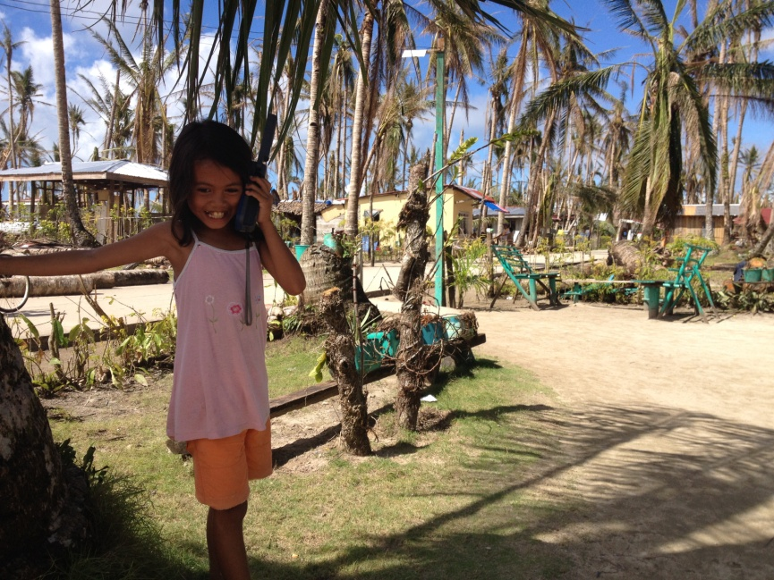
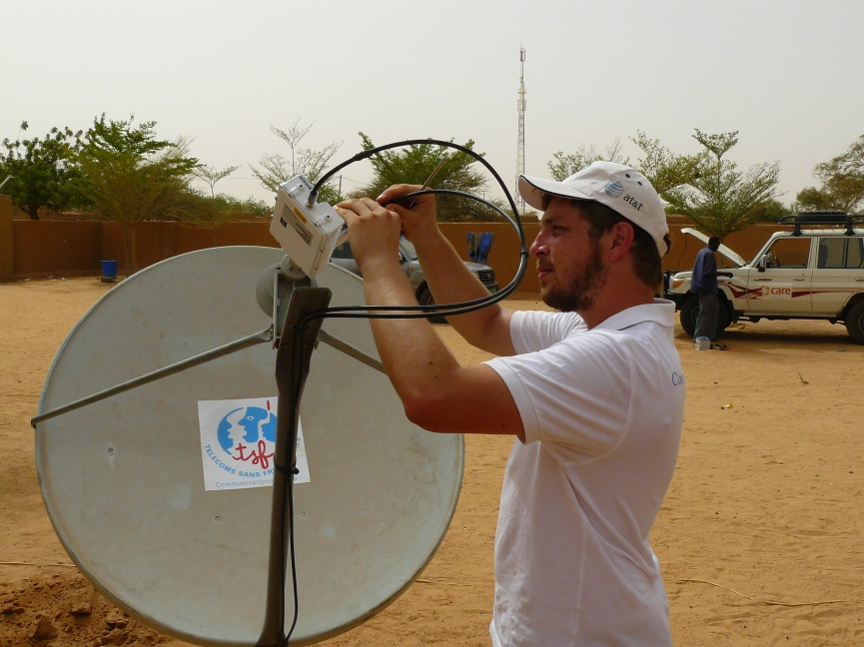
Télécoms Sans Frontières Communications for life
Thank you!

