Slide 1
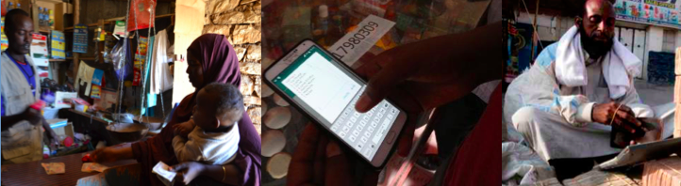
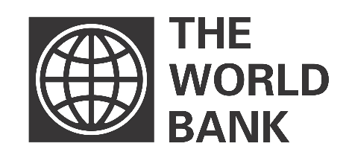
Mobile Money in Somalia
Household Survey and Market Analysis
March 2017

Slide 2
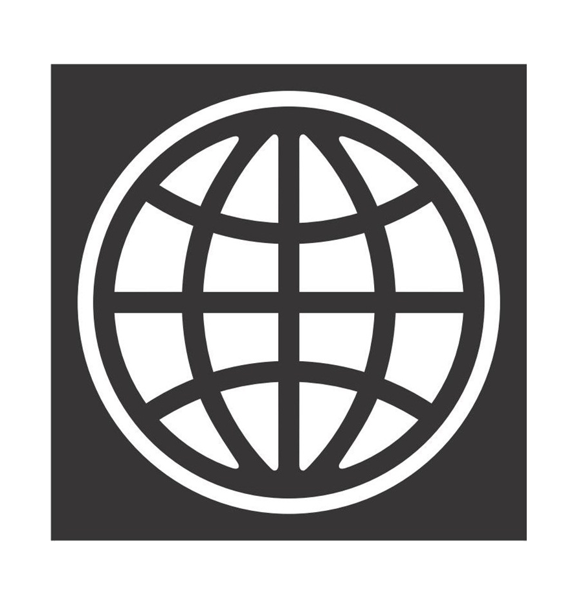
Agenda
1. Executive Summary
2. Introduction and Context
3. Penetration rates
4. Financial practices
5. Usage patterns of mobile money
6. Perceptions around mobile money
7. Triggers for adoption and barriers to adoption
8. Recommendations
9. Appendix

Slide 3
1.1 Executive Summary > Key Findings
Penetration of mobile money
73% of the population above the age of 16 use mobile money services, broken down as 83% in urban areas, 72% in rural areas and 55% in rural areas. The differences across zones are more significant in rural areas.
Puntland has the highest mobile money penetration rate, closely followed by Somaliland. South Central exhibits high heterogeneity of mobile money penetration among its Federated Member States.
The penetration rate of mobile money is Each zone is dominated by one mobile money service (Hormuud’s EVC Plus in South Central, Golis’ Sahal in Puntland and Telesom’s Zaad in Somaliland).
By comparison, overall penetration rates of banking services remain very low, at 15.5% for the entire population.
Of those who receive a monthly salary, payment or allowances, more than half receive their salaries or allowances directly on their mobile money account.
63% of mobile money users keep their funds in the ecosystem. Receiving salaries on a mobile money account prompts more active and varied usage of other mobile money services, including utility and merchant payments.
For international transfers, Hawala is still used most commonly, though remittances companies are increasingly partnering with Mobile Network Operators to transfer international money directly to the mobile money accounts.
Most mobile money transactions take place within Federated Member States (FMSs). Banadir is the exception, with most mobile money originating from Banadir being sent to the other FMSs in South Central. Mobile money is regularly transferred across FMSs in South Central. On the contrary, Somaliland is an autarchic zone.
Practicalities and mobile money usage
Perceptions around mobile money
Overall, Somalis praise Mobile Network Operators for providing much needed services in the entire country. However, some do not trust them as the system remains unregulated. Mobile money is deemed fast and convenient by Somalis, with a 92% satisfaction rate.
However Somalis think that mobile money can be prone to technical issues and mistakes. Users also deplore some problems with e-float management/cash out and the lack of interconnectivity between the different mobile money services.
USD versus Shillings
USD is commonly used for all types of transactions, and in particular to pay for durable goods, to send/receive money from friends/family and to cash out money. Urban populations are more favourable towards USD.
SSH are mostly used for small daily expenses. SSH remain popular among the rural and IDPs for paying everyday expenses.
The perception that mobile money is responsible for the devaluation of the local currency and inflation is widespread. Almost 90% of Somalis would be interested in mobile money being available in SSH.

Slide 4
Agenda
1. Executive Summary
2. Introduction and Context
3. Penetration rates
4. Financial practices
5. Usage patterns of mobile money
6. Perceptions around mobile money
7. Triggers for adoption and barriers to adoption
8. Recommendations
9. Appendix

Slide 5
2.1 Introduction > Context
Mobile communications is one of the bright spots in the Somali economy. In a country where a very large part of the population is still unbanked, mobile money is a major development.
Potential
Somalia boasts a developed ICT sector and telecommunication infrastructure, with five main Mobile Network Operators (MNOs) operating across the country, several of which between the different zones and federal states¹.
The increased availability and popularity of mobile phones in Somalia has also led to the development of mobile money services. The 2014 Global Financial Inclusion Survey report indeed reveals that Somalia is one of the most active mobile money markets².
Partnerships between Mobile Network Operators, banks, and remittance companies now enable mobile money account-to-bank account transfers and transfer of international remittances directly to the mobile money accounts.
Opportunities
In the Somali peninsula, which lacks a strong formal banking system, shifting to digital payments can improve the efficiency of making payments by increasing the speed of a transaction and by lowering the cost of disbursing and receiving them. It can also enhance the security of payments and provide a safe way for Somalis to store money. Lastly, it provides an accessible and scalable means of extending financial services to those who are currently unbanked.
Leveraging the full potential of Somalia’s mobile money industry could a) increase the number of customers and b) spur greater use of accounts. This would offer impetus for providers to expand upon the services they offer and for the wider financial services to capitalize through offering associated services. For instance, as the country receives an estimated remittance inflow of over $1.3 billion each year³, there is space for the link between remittances and mobile money in Somalia to be further developed. In addition, the government and the private sector could play a pivotal role by shifting the payment of wages and government transfers from cash into mobile money accounts.
Hormuud (South Central), Golis (Puntland), Telesom (Somaliland), Somtel (South Central, Puntland and Somaliland), Nationlink (South Central, Puntland and Somaliland)
World Bank Global Financial Inclusion Survey, 2014, http://bit.ly/2nF5a91
Baseline Assessment of the Technical Assistance Fiche, Supporting the Central bank of Somalia’s Regulation of Mobile Money to Strengthen and Safeguard Remittances, ACP EU Migration Action, 2015

Slide 6


1.1 Introduction > Context
2.1 Introduction > Context
Growth in Somalia’s mobile money market faces stark, but surmountable, challenges. A multi-phased program of technical support for the ICT regulatory framework and enabling environment has been set up by the World Bank.
Challenges and risks
The potential of mobile financial services in Somalia is stunted by several factors, including financial instability caused by a weak formal banking sector and the lack of regulation both in relation to mobile operators and mobile money services. Not least among the risks of an absence of regulation are the lack of customer protection, no buffer against discriminatory or other anti-competitive practices among providers, as well as money laundering and diversion of funds to terrorist organizations.
This runs counter to the global market trend where it is increasingly recognized that with conductive regulatory frameworks, policy makers and mobile money service providers can play a major role in fostering financial inclusion¹.
Project
Against this backdrop, the ICT Sector Support in Somalia project is working to advise on mobile money best practices and to support the development and implementation of an effective regulatory framework and enabling environment for mobile money. The project is a collaboration between the ICT Sector Unit of the World Bank Group, the Central Bank of Somalia (CBS), the Ministry of Posts and Telecommunications (MPT) and the Ministry of Finance (MoF) of the Federal Government of Somalia (FGS).
Altai Consulting has been contracted to implement the research component of the project.
Mobile Banking and Financial Inclusion – The Regulatory Lessons, Michael Klein and Colin Mayer, The World Bank Financial and Private Sector Development Public-Private Infrastructure Advisory Facility, 2011

Slide 7
1.1 Introduction > Purpose and objectives of the research
2.1 Introduction > Purpose and objectives of the research
The research was articulated around five research questions.
The research was articulated around five research questions.
1
How does mobile money work in Somalia and Somaliland?
2
How is mobile money circulating across the financial landscape of Somalia and Somaliland?
3
What does the dollarization of the economy mean for the mobile money sector?
4
To what extent do people and firms rely on mobile money in Somalia and Somaliland? And what are the advantages and risks of the current system?
5
How can the mobile money ecosystem be further built upon? And how can the sector provide greater financial inclusion for Somalis and economic contribution to the development of Somalia and Somaliland?

Slide 8
1.2 Introduction > Research components
2.2 Introduction > Research components
The data collection was organized around three modules.
Modules
Objectives
Approach and methodology
1
Quantitative demand-side research: household survey
Assess mobile money usage patterns
(including demand, usage volume and preferences vis a vis formal and informal domestic payments and international remittance services, potential, etc.)
Demand-side questionnaire designed and pilot-tested
Enumerators trained and sampling design finalised
Survey rolled out to sample 1,500+ households
2
Qualitative demand-side
research: Focus Group Discussions
Understand the reasons behind usage of mobile money (or lack of) and the drivers and barriers to adoption of mobile money across user categories
12 Focus Group Discussions (FGDs) with various categories (across zones) to dive deeper into the target populations’ needs and current behaviours
At-risk populations and SMEs included for rounded insight
3
Qualitative supply-side research: In-Depth Interviews and visits to agents
Understand the mobile money ecosystem in Somalia and Somaliland, analyse current remittance channels and understand the role played by agents
15 In-Depth Interviews (IDIs) of sector experts, incl. government authorities and academics, Mobile Network Operators, remittance services providers, banks, etc.
9 face-to-face interviews with mobile money agents
18 mystery visits to agents

Slide 9
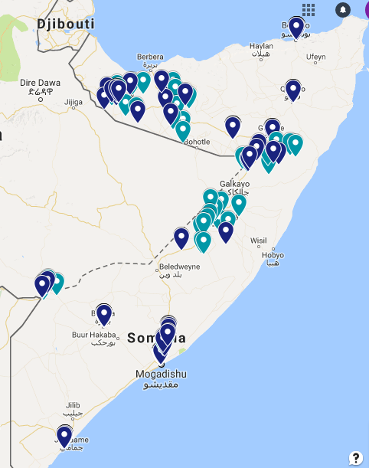
1.2 Introduction > Research components
2.2 Introduction > Research components
1,796 respondents have been successfully interviewed during the quantitative data collection, completed in December 2016.
Stratification
The sampling frame was divided between economic zones (South Central, Puntland, and Somaliland), then further broken down between urban areas, rural areas and IDP camps.
Sampling
The survey sampling frame was constructed based on the UNFPA PES Survey and the last round of the SHFS.
With a sample size of 1,540 interviews, the survey achieves a margin of error of 3% with a confidence level of 95%.
The design was a stratified four-stage cluster sample, with Probability Proportional to Size (PPS) of selection for the districts and EAs. Households within the EA were selected using a random walk method. Respondent within the household were selected through a randomization formula within the encoded questionnaire, among the adults above 16 present at the time of the interview. Oversampling was used to minimize the need to redo-interviews.
Questionnaire
A questionnaire translated in Somali, with 110+ questions, was used.
Calculations & tools
The databased is composed of 1,796 valid and successful interviews. The database has been cleaned and post-weighted according to demographic data. The calculations were conducted on Stata.
1800+ respondents have been interviewed all over the country

Slide 10
1.3 Introduction > Challenges and limitations
2.3 Introduction > Challenges and Limitations
When reviewing the results, some challenges and limitations should be taken into consideration. Importantly, the quantitative survey is not representative of the entire Somali population, as the sampling frame excluded nomadic populations and inaccessible areas on security reasons.
Challenges
Limitations
1
Survey implemented during the electoral process: worsened security conditions in Somalia, and in particular in Mogadishu.
1
The quantitative survey is not representative of the entire Somali population: i) nomads were not surveyed; ii) only accessible areas (on security reasons) were included in the sampling frame. Around 40% of the Somali territory was removed from the sampling frame.
Disclaimer: The statistics presented in this presentation only account for the areas included in the sampling frame. As nomadic populations and populations living in areas assessed as inaccessible are likely to have lower levels of access to mobile money, the estimates are likely to overestimate penetration and volumes of mobile money, would one like to infer statistics on the entire Somali population.
2
Severe drought in Somalia and Somaliland: complicated the data collection for the survey in rural areas.
3
In Somaliland, issuance of a government decree banning the use of mobile money transfer services for less than $100 transactions: sensitivity around mobile money and difficulty to find mobile money agents willing to be interviewed.
2
The option chosen for the selection of respondents within the household (randomization among household members above 16 present at the time of the interview) introduces a bias. However, the sampling weights were adjusted to correct for this within-household coverage bias.
3
Results of the household survey are based on respondent self-reporting.

Slide 11
Agenda
1. Executive Summary
2. Introduction and Context
3. Penetration rates
4. Financial practices
5. Usage patterns of mobile money
6. Perceptions around mobile money
Triggers for adoption and barriers to adoption
Appendix

Slide 12



2.1 Penetration rates > Phone and sim ownership
3.1 Penetration Rates > Mobile Phone and SIM ownership
Draft
73% of the population over the age of 16 use mobile money services.
90% of Somalis own at least one mobile phone and among these phone owners, a majority has a basic phone.
Phone Ownership
Focus on phone owners
Of mobile phone owners, 83% subscribe to mobile money services.
Almost a third have a smartphone
Mobile money subscribers
Entire sample
Focus on SIM owners
Sample sizes: 1,796 (entire sample); 1,617 (phone owners)
Questions: Do you own one or more mobile phone(s)?, What type of mobile phone(s) do you own?
Sample sizes: 1,796 (entire sample); 1,581 (SIM owners)
Questions: Have you, personally, subscribed to a mobile money service on one of your own SIM(s)?
Note: * 0.2% responded “don’t know”.
Notes:
2 slides only –con
Finish this!!

Slide 13
2.1 Penetration rates > Phone and sim ownership
3.1 Penetration Rates > Mobile Phone and SIM ownership
Draft
Over 88% of Somalis have at least one SIM card. Somalis have an average of 1.4 SIMs per person. Somaliland, Puntland and South Central are respectively dominated by Telesom, Golis and Hormuud.
SIM ownership
Entire sample
SIM ownership
Focus on phone owners
SIM ownership per operator
Focus on SIM owners
Telesom dominates Somaliland
Golis dominates Puntland
* 0.03% responded “don’t know”.
SIMs per person
Focus on SIM owners
An average of 1.4 SIMs per person
Hormuud dominates South Central
Sample sizes: 1,796 (entire sample); 1,617 (phone owners); 1,581 (SIM owners)
Questions: Do you own one or more SIM card(s)?; How many SIM card(s) do you have?; Which are the operator(s) of your SIM card(s)?
Notes:
Slide 32

Slide 14
3.2 Penetration rates > Mobile money penetration rates
3.2 Penetration rates > Mobile money penetration rates
Puntland has the highest mobile money penetration rate, closely followed by Somaliland. South Central exhibits high heterogeneity of mobile money penetration among its Federated Member States.
Zone mobile money penetration rates
Entire sample
Federated Member State mobile money penetration rates*
Entire sample
Puntland has more subscribers as a percentage of its population
*The Federated Member State data is indicative, as the sampling is only representative at the zone level.
The gap between penetration rates in Banadir and Jubaland, both within South Central, demonstrates the heterogeneity of mobile money take-up across South Central
Sample size: 1,796 (entire sample)
Question: Have you, personally, subscribed to a mobile money service on one of your own SIM(s)?

Slide 15
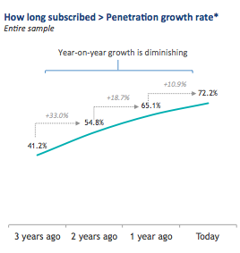
2.2 Penetration rates > Mobile money penetration rates
Mobile Money Usage > Year-on-year Growth Rate & Demographic Variation
Draft
3.1 Penetration Rates > Demographic Details and Market Saturation
More than half of mobile money users subscribed over 3 years ago. Uptake is growing overall as the industry has faced significant year-on-year growth over the past few years. But year-on-year growth is decreasing, suggesting market saturation of existing ecosystem.
Gender subscription timeline
Focus on mobile money subscribers
Women are catching up to men. The year-on-year penetration growth rate has been higher for women than for men over the last year
Type subscription timeline
Focus on mobile money subscribers
Urban users have embraced mobile money sooner than their displaced and rural counterparts
‘People you meet will ask you ‘Do you have Mobile Money?’. If you say no, they may ask you ‘How can I send you money then?’. So, you see, this situation forces you to use mobile money, and this is the real reason why almost everybody in Somalia uses mobile money.’ (Abdulahi, South Central)
Sample sizes: 1,328 (mobile money subscribers)
Questions: How many years ago did you first subscribe to mobile money services?
Notes:
Women’s usage of mobile money is alsoshowing year-on-year growth that currently surpasses that of men.
MM uptake is growing overall, but year-on-year growth (annual growth rate) is decreasing, suggesting market saturation of existing ecosystem (MM context is impressive, but the sector can do more)

Slide 16
3.2 Penetration rates > Mobile money penetration rates
Could cut?
3.2 Penetration rates > Mobile money penetration rates > Demographic Variation
Men, users aged between 16–35, literate, more educated and wealthier people tend to subscribe more to mobile money and use it more actively than other sub-groups. Almost all users are active users.
Mobile money penetration
Entire sample
Mobile money active usage³
Entire sample
Overall
Gender
Male
The gender gap is 5%
Female
Age
16 - 25
26 - 35
36 – 50
Usage of 50+ lags behind those of younger sub-groups
50+
Literacy
Literate
Illiterate
Education
Higher level¹
More educated sub-groups subscribe more and use mobile money more actively
Lower level²
Monthly income
≤ 100 USD
> 100 USD and ≤ 150 USD
> 150 USD and ≤ 200 USD
> 200 USD and ≤ 250 USD
Wealthier sub-groups subscribe more and use mobile money more actively
> 250 USD and ≤ 300 USD
>300 USD and ≤ 500 USD
> 500 USD
Sample size: 1,796 (entire sample)
Questions: Have you, personally, subscribed to a mobile money service on one of your own SIM(s)?; When was the last time you used mobile money services?
Higher level includes those who completed secondary education/high school or a Bachelors or a Masters or more and/or a technical education/vocational training.
Lower level includes those who have no education or completed a primary education and/or a religious education.
(3) Active users are mobile money subscribers who have used mobile money services within the last 3 months.

Slide 17
3.2 Penetration rates > Mobile money penetration rates
3.2 Penetration rates > Mobile money penetration rates
Each zone is dominated by one mobile money service. Yet, as competition increases, a lack of interconnectivity across services sometimes requires users to use multiple mobile money services to stay connected.
Number of mobile money services used
Focus on mobile money subscribers
Mobile money services used by zone
Focus on mobile money subscribers
EVC-Plus by Hormuud has a virtual monopoly in South Central
<
Almost 1 in 6 people in Somaliland use at least 2 services
<
Sample size: 1,328 (mobile money subscribers)
Question: Which operator(s) have you subscribed to a mobile money service(s) with?

Slide 18
3.3 Penetration rates > Banking services penetration rates
3.3 Penetration rates > Comparing Between Mobile Money and Banking Services
3.3 Penetration rates > Banking services penetration rates
Overall penetration rates of banking services remain very low, at 16% for the entire population above 16. Men, people aged 26-35, literate, more educated and wealthier people use more banking services.
Banking penetration
Entire sample
Overall
Gender
Male
The gender gap between male and female users is larger for banking services (8%) than it is for mobile money services (5%)
Female
Age
16 - 25
26 - 35
The penetration of banking services for people aged 16-25 is very low, while it was the second group in terms of mobile money penetration, just after the 26-35
36 – 50
50+
Literacy
Literate
Illiterate
Education
Higher level¹
The differences between high educated and low educated people are even more important for banking services than for mobile money services
Lower level²
Monthly income
≤ 100 USD
> 100 USD and ≤ 150 USD
> 150 USD and ≤ 200 USD
> 200 USD and ≤ 250 USD
> 250 USD and ≤ 300 USD
>300 USD and ≤ 500 USD
> 500 USD
Sample size: 1,796 (entire sample)
Question: Do you currently have an account, by yourself or together with someone else, at a bank (either in a commercial bank or an Islamic bank)?
Higher level includes those who completed secondary education/high school or a Bachelors or a Masters or more and/or a technical education/vocational training.
Lower level includes those who have no education, or who completed primary education and/or a religious education.

Slide 19
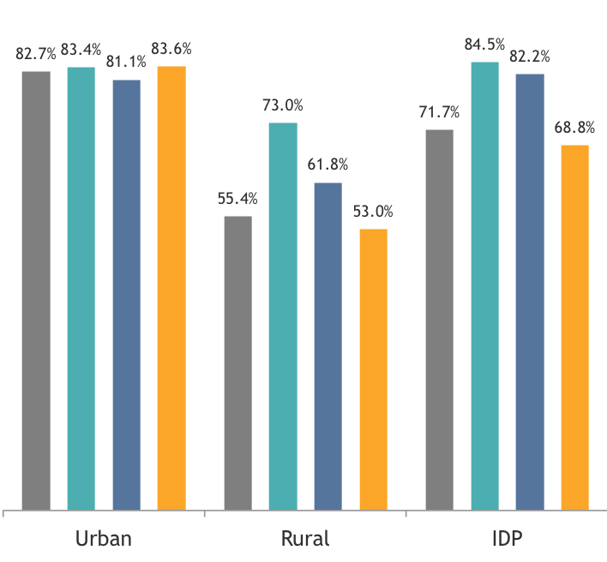

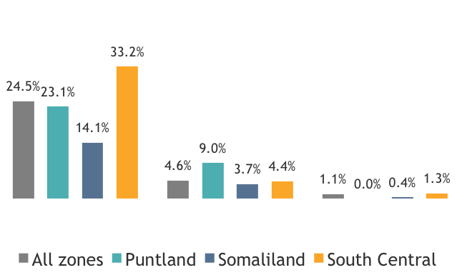

3.3 Penetration rates > Comparing Between Mobile Money and Banking Services
Draft
The penetration rate of banking services for the entire population masks significant disparities between urban areas and rural areas. Only 5% of rural populations and 1% of IDPs have a bank account.
Penetration rates by type
Entire sample
Country Comparison: Kenya stays ahead in terms of mobile money penetration, but not by much. The gap is far greater in terms of bank accounts penetration.
Somalia
Kenya*
2014 figure: bank accounts penetration is likely to be higher at the time of writing this presentation
Different estimates could be found for mobile money penetration in Kenya, ranging between 72% to 85%
Sample size: 1,796 (entire sample)
Question: Do you currently have an account, by yourself or together with someone else, at a bank (either in a commercial bank or an Islamic bank)?
Notes:
PRESENT THIS: FROM “VISITS TO AGENTS Bank branches can only be found in urban centers, explaining the high discrepancies between the penetration rates in urban areas and in rural areas.
‘There are no bank branches in our village, and accessing banks is hard since banks are located in the urban areas’ (Fardowso, Puntland)
To open a bank account, one needs to submit a passport, a national identification card, a job identification card or a driver’s license, documents that the poorer quartiles of the population and displaced populations rarely possess. The quantitative data collection highlights that only 43.8% of the population owns an official ID document. This number comes down to 23.9% in rural areas and 20.0% in IDP camps.*

Slide 20
Agenda
1. Executive Summary
2. Introduction and Context
3. Penetration rates
4. Financial practices
5. Usage patterns of mobile money
6. Perceptions around mobile money
Triggers for adoption and barriers to adoption
Appendix

Slide 21




4.4 Financial practices > Comparison of systems in use
4.1 Financial Practices > Mobile money reliability and comparison to other systems in use
To what extent do people and firms rely on mobile money in Somalia and Somaliland? And what are the
advantages and risks of the current system?
Service delivery compared to other mechanisms:
  • Given the depreciation of the local currency and lack of other satisfying and accessible-to-all alternatives, people and firms rely heavily on mobile money for their daily money transfers. Mobile money has a crucial role and has become the first financial instrument in Somalia, while cash is less and less used.
Cash
Mobile money
Hawala
Bank
Penetration¹
Usage²
Use cash to pay for groceries
Use MM for domestic transfers
Use hawala for domestic transfers
Use banks for domestic transfers
Rationale
A large portion of Somalis do not carry cash anymore.
The Somali/Somaliland Shillings are weak and the hard currency is progressively disappearing.
Mobile money services are booming and are used to purchase goods, pay bills, receive salaries, receive money from families, friends and relatives, etc.
Mobile money seems to respond well to Somalis’ needs.
Money transfer agencies, based on hawala, are still important actors in Somalia’s financial sector.
Hawalas and mobile money operators are partnering to capitalize on the best that each service has to offer.
Somalia is beginning to slowly rebuild its institutions, including its banking system.
Yet the Somali financial sector remains underdeveloped and unsupervised, with a very low penetration of banking services.

Slide 22
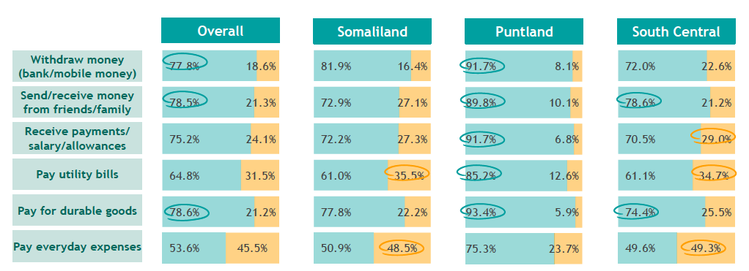
3.3 Financial practices & user practicalities > USD vs. SSH
4.1 Financial Practices > USD vs Somali Shilling
Draft
USD is commonly used for all types of transactions, and in particular to pay for durable goods, to send/receive money from friends/family and to cash out money. Somalis living in Puntland are the most likely to use US dollars while those in South Central are least likely.
Currency used (USD vs Somali Shillings)
Sample varying for each question
  In addition, urban populations use USD more prevalently across regions. The rural and IDPs also send and receive money most commonly in USD, but SSH remains their dominant mode for paying everyday expenses.
Sample sizes: Withdraw: 1,342 (those who own a bank and/or a MM account); Salary: 787 (those who received a salary over the past month); Everyday expenses: 1,796 entire sample); Durable: 897 (those who paid for durable goods); Bills: 1,562 (those who pay for utility bills+DK); Send/receive: 1,211 (those who send or receive money)
Question: In which currency do you: pay the majority of your every day expenses/usually pay utility bills/durable goods/receive your payments, salary or allowances most often/witdraw money/usually send or recieve money from friends, relatives, or family?
The differences between the % of USD and SSH correspond to the ‘Don’t know/Refuse to answer’ answers.
Notes:
Focus on the notable difference between Puntland and SC’s use of the dollar
People mostly use dollars to pay for groceries, school fees, their rent and utility bills, durable goods etc. They use the Somali/Somaliland Shillings for small daily expenses. ‘I generally have very little cash in my pocket. I only use Shillings for having tea, paying for shoe shinning, bus transport fee, and as charity to beggars in the street. ’ (Hassan, South Central)
In rural areas, people trust Shillings more; they know its value while the dollar can be confusing. Most of them continue using Shillings to pay for daily expenses.
ZOOM IN QUOTES talk about - issues with the dollarization of the economy and depreciation of the local currency

Slide 23
4.2 Financial Practices > Remittances & Domestic Transfers
36.5% have received international remittances over the last year. Remittances companies are increasingly partnering with Mobile Network Operators to transfer international money directly to the mobile money accounts.
Domestic Transfer
International Transfer
Mobile money dominates domestic transfers
Formal transfer
Mobile money
Hawala Money Transfer Operator transfer
Over-The-Counter
mobile money
Hawala is stil used most for international transfer
Non-hawala Money Transfer Operator transfer
Bank transfer
Formal banking services are not yet commonly used
Cheque
Informal transfer
Cash
Through someone else
Towards a cash-less economy?
Exchange goods
Notes:
Notes for presenter:
Mobile money dominates domestic transfers, both through a personal account and through Over-the-Counter transactions
On International remittance origin countries:
United States (36%) and Yemen (22%) source the most international remittances
UK (19.3%) and Sweden (15.3%) come up next
Neighboring Ethiopia (0.1%) and Djibouti (0.4%) are both very low, with Kenya also only 3.8%

Slide 24
4.2 Financial practices > Practicalities to send and receive money
Could cut? Either this or the one following
4.2 Financial practices > Practicalities to send and receive money
4.3 Financial practices > Practicalities of sending and receiving money
A third of all recipients of international remittances receive money originating from the United States, whilst 19% money from the United Kingdom.
Origins of international transfers
Focus on those who receive money internationally
North America
United States
Canada
Middle East
Saudi Arabia
UAE
From the FGDs
‘I receive money from London, sent by my uncle, through hawala. We rely on this every month to cover our bills and this is the only source which supports the household in our daily lives.’ (Salaben, South Central)
‘Donation from my cousins in Finland is one of the most important sources of revenues for my household.’ (Hassan, South Central)
Yemen
Europe
United Kingdom
Sweden
Norway
Germany
Denmark
The Netherlands
Finland
France
Italy
Africa
South Africa
Kenya
Djibouti
Ethiopia
Other
Australia
Other
Sample size: 619 (those who receive money from abroad)
Questions : Which countries do you usually receive money from?
Other countries included: Turkey, Russia, Austria and Uganda.
0.9% responded ‘Don’t know’ and 0.4% of respondents refused to answer.

Slide 25
4.2 Financial practices > Practicalities to send and receive money
Could cut? Either this or the one previous
4.2 Financial practices > Practicalities of sending and receiving money
Sources of international remittances
7%
2%
11%
3%
19%
2%
1%
3%
9%
1%
33%
5%
11%
2%
0.5%
0.1%
4%
10%
2%
33%
0%
% of international remittances recipients who receive money from that specific country
Sample size: 619 (those who receive money from abroad)
Questions : Which countries do you usually receive money from?
Other countries included: Turkey, Russia, Austria and Uganda.
0.9% responded ‘Don’t know’ and 0.4% of respondents refused to answer.

Slide 26
4.2 Patterns of use of mobile money services > Directions/vectors of transfer
Could cut?
4.3 Financial practices > Vectors of transfer > Urban to Rural
Draft
Mobile money originates from urban areas. For respectively 89,3% and 80% of the IDPs and rural populations, the majority of incoming mobile money transfers are sent from urban areas.
Mobile money being received from
Focus on those who send mobile money domestically
All types
From the FGDs
‘I work in Hargeisa. I regularly send money to my village and my family through mobile money. The village depends on the money they receive from the sons and daughters who left for the city.’ (Abdikarim, Somaliland)
Respondents
from
IDP
Rural
Urban
Sample sizes: 729 (those who receive mobile money domestically)
Question: Which Federated Member States do you usually receive mobile money from?
Notes:
[TO KEEP?] Consolidate this slide, add to an earlier one or make more interesting?

Slide 27
4.2 Patterns of use of mobile money services > Directions/vectors of transfer
4.3 Financial practices > Vectors of transfer > Vectors of Transfer > Inter-Regional Transfers
Draft
Most mobile money transactions take place within a state. Benadir is the exception, with most mobile money originating from Benadir being sent to the other FMSs in South Central. Mobile money is regularly transferred across FMSs in South Central. Somaliland is an autarchic zone.
People from Benadir do not send much mobile money within Banadir. Instead they send money to South-West, Jubaland and HirShabelle
Money circulation among Federated Member States
Focus on those who send mobile money domestically
Mobile money sent to
Benadir
Benadir
Respondents from
Except for 3.7% who send to Puntland and 0.3% who send to Jubaland, Somalilanders almost exclusively send money within Somaliland
Galmudug, HirShabelle and Jubaland send money to Benadir
Notes:
IMPORTANT SLIDE, make sure we know how to talk about this well
Mobile money originates from urban areas. For respectively 89,3% and 80% of the IDPs and rural populations, the majority of incoming mobile money transfers are sent from urban areas.

Slide 28
Agenda
1. Executive Summary
2. Introduction and Context
3. Penetration rates
Financial practices
Usage and patterns of mobile money
6. Perceptions around mobile money
Triggers for adoption and barriers to adoption
Appendix

Slide 29
5.1 Usage patterns of mobile money > Patterns and mobile money services commonly adopted
5.1 Usage patterns of mobile money > Keeping mobile money in the ecosystem
63% of mobile money users do not withdraw or transfer all of the money out of the account straight away once a transfer is received into the account, but rather transfer the money over time as and when needed. Mobile money further circulates into the economy.
Withdrawing once an important amount is transferred into the account
Focus on mobile money users
Mobile money is used to
Pay education fees for 70.2% of mobile money users;
Disburse donations/charity for 56.4% of mobile money users;
Receive vouchers from the government for 35.5% of mobile money users;
Shop online (e-Purchases) for 28.3% of mobile money users;
Receive cash transfers from NGOs for 18.0% of mobile money users;
Pay government taxes for 16.7% of mobile money users.
  Only a quarter of the money received through mobile money is cashed out immediately
  This implies that the “money supply” is constantly expanding and therefore driving inflation.
  In addition this creates a large float of cash for the main operators, which given the lack of regulation, can be used for various uses (Ex. For other investments) with minimum repercussion.
Sample size: 1,328 (focus on mobile money subscribers)
Question: Once an important amount is transferred into your mobile money account (e.g. payment from an employer or clients), do you usually withdraw or transfer all of the money out of the account straight away, or do you withdraw or transfer the money over time as and when you need it?

Slide 30
5.1 Usage patterns of mobile money > Patterns and mobile money services commonly adopted
Could cut?
5.3 Usage patterns of mobile money > Keeping eMoney in the Ecosystem
Send and receive money domestically, transfer airtime and pay merchants are the mobile money services with the highest frequencies of use. In terms of amounts transferred, receive internationally, receive salaries, save money and send and receive domestically dominate. Somalis take out money more often than they deposit money.
Mobile money services
Penetration
Focus on mobile money subscribers
Average number of transactions per month¹
Average amount spent/sent/ received per month (USD)²
Take out
Deposit
A lot of airtime transfers but for small amounts
Transfer airtime
Bill payment
Receive domestically
Send domestically
Purchase airtime*
Merchant payment
Salary/allowances
Low frequencies of such transactions but for important amounts
Reimburse loans
Save money
Receive internationally
Sample size: 1,328 (mobile money subscribers)
Questions: Do you use mobile money services to do…?; Over the past month, how many times did you use mobile money for…?; Over the past month, what was the total amount you spent/sent/received on …?
(1) Mean average of number of times the specific service was used over last month for all mobile money users
(2) Mean average of the amount spent/sent/received over last month for mobile money users who have used the specific service at least once over the last month
* Include airtime and Internet bundles.

Slide 31
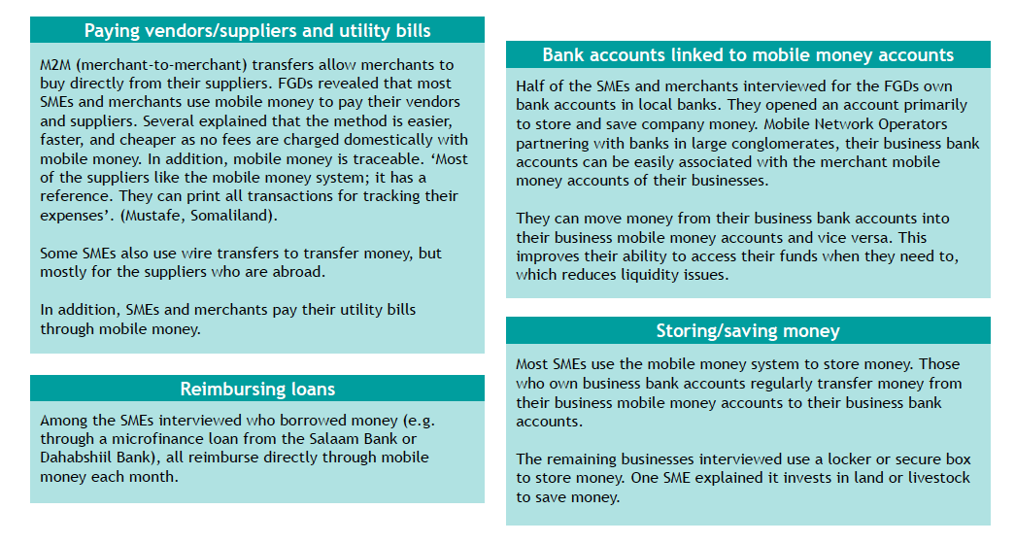
Could cut?
5.2 Usage patterns of mobile money > Mobile money use by SMEs and merchants
SMEs and merchants also largely rely on mobile money to pay their utility bills, remunerate vendors and suppliers, store money, and repay borrowed funds.

Slide 32
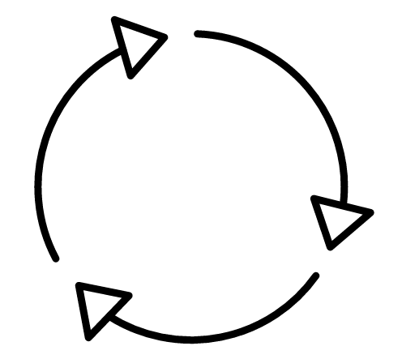

5.1 Usage patterns of mobile money > Patterns and mobile money services commonly adopted
5.4 Usage patterns of mobile money > mobile money services commonly adopted
For the average mobile money user in Somalia, P2P transfers amount to $91 per month, merchant payments to $42 per month and bill payments to $44 per month. The average user receives $90 per month in disbursements (salaries, cash transfers from NGOs) and $19 of international remittances on his/her mobile money account.
A month in the life of an average mobile money user
Focus on mobile money subscribers
P2P TRANSFERS
CASH OUT
    8.6 transactions per month
    $ 91 per month
    4.0 transactions per month
    $ 82 per month
CASH IN
    2.6 transactions per month
    $ 76 per month
AIRTIME TOP-UP
    2.0 transactions per month
    $ 13 per month
DISBURSEMENTS
    0.9 transactions per month
    $ 90 per month
BILL PAYMENTS
    1.8 transactions per month
    $ 44 per month
INTERNATIONAL REMITTANCES
    0.1 transactions per month
    $ 19 per month
MERCHANT PAYMENTS
    3.9 transactions per month
    $ 42 per month
Sample size: 1,328 (mobile money subscribers); Calculations: Mean averages for all mobile money users; P2P transfers are calculated as (sending transactions + receiving transactions)/2 + airtime transfers to avoid double-counting of domestic transfers; Disbursements are calculated as salaries + cash transfers from NGOs. Respondents were asked whether they received a cash transfer from an NGO through mobile money over the last month. Interviews with NGOs and with displaced populations enabled to compute the average amount transfered per person for such transfers ($200 over six months, or $33.3 per month).

Slide 33
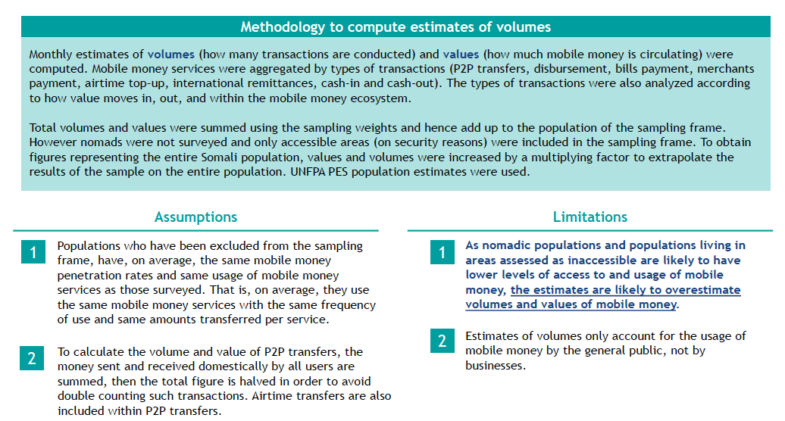
5.4 Usage patterns of mobile money > Volumes of Mobile Money
Volumes of mobile money were computed based on different assumptions. Given that the sampling frame excluded some populations and areas like t have lower levels of mobile money usage, it is likely that the country-wide estimates are over estimated.

Slide 34
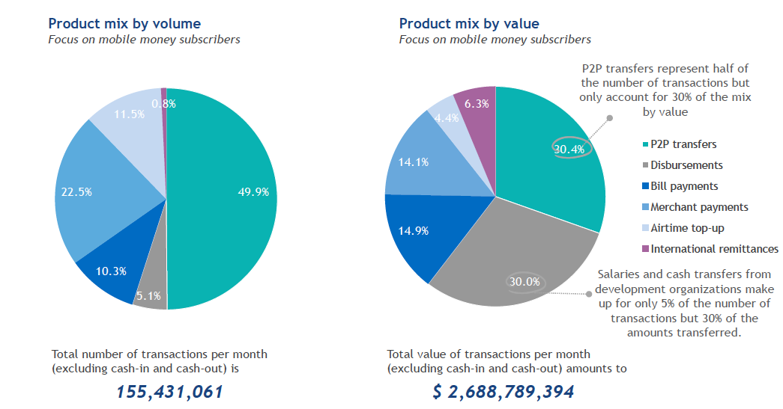
Volumes
5.4 Usage patterns of mobile money > Volumes of Mobile Money
P2P transfers dominate the mix by volume and by value. At the same time, the large numbers of salary disbursements, utility payments, and merchant P2B payments reflect an expanding ecosystem of institutions and businesses entering the ecosystem.
Sample size: 1,328 (mobile money subscribers)

Slide 35
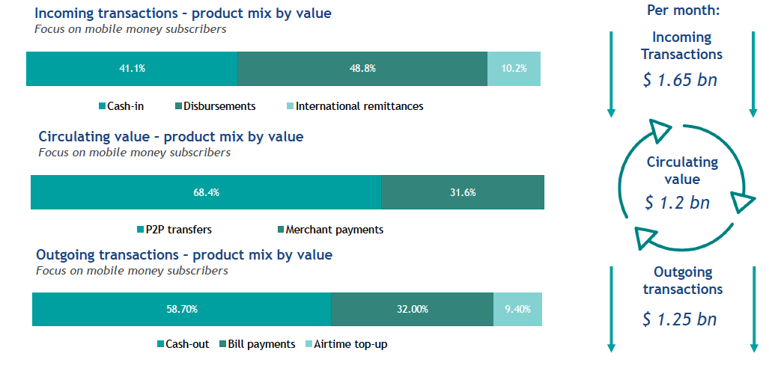
5.4 Usage patterns of mobile money > Volumes of Mobile Money
$ 1.2 bn is circulating in Somalia’s mobile money ecosystem every month
Sample size: 1,328 (mobile money subscribers)
Note: We compared the above method of estimating the circulating value (P2P and merchant payments) with one that measures the circulating value by multiplying the same above value for incoming transactions by the percentage of those who do not immediately withdraw the mobile money from their account once they receive a transfer. This leaves a total circulating value of $ 1,043,630,207 in the mobile money ecosystem. Whilst not exactly equal, this value is comparable in order of magnitude to our chosen method’s value of 1,196,399,615.

Slide 36
Agenda
1. Executive Summary
2. Introduction and Context
3. Penetration rates
Financial practices
Usage and patterns of mobile money
6. Perceptions around mobile money
Triggers for adoption and barriers to adoption
Appendix

Slide 37
5 Perceptions about mobile money services
6.1 Perceptions About Mobile Money Services > Advantages & Disadvantages
Draft
For a significant portion of Somalis, mobile money is unreliable and unsafe (with regards to the safety of the money). In contrast, Hawalas transfers are assessed as slower than mobile money transfers but safer.
Advantages by type of service
Entire sample
Surprisingly, bank transfers and hawala transfers are thought to be of higher value for money than mobile money transfer
Disadvantages by type of service
Entire sample
From the FGDs
‘The system is risky. Everybody uses mobile money and the services depend on private business companies which might collapse any time without notice, and therefore it might affect our lives. This is a fear we keep in our hearts.’ (Sahan, South Central)
Notes:
[FOR ADVANTAGES FIGURE: Among mobile money transfers, bank transfers and hawala transfers, Somalis think that mobile money transfers are simpler to use and faster, but less safe with regards to the safety of the money. Bank transfers are judged more reliable but slower.]

Slide 38
5 Perceptions about mobile money services
6.1 Perceptions About Mobile Money Services > Mobile Money’s Link to Dollarization
Draft
The perception that mobile money is responsible for the devaluation of the local currency and inflation is widespread. Almost 90% of Somalis would be interested in mobile money being available in Shillings.
A fact: mobile money has made the Somali economy even more dollarized.
‘My salary is paid in dollars, and dollars dominate the national currency. Mobile money solved most of the needs by allowing people to buy goods easily and to meet their needs, so now the country seems even more dependent on Dollars.’ (Mohamed, South Central)
From the FGDs
Is mobile money responsible for the devaluation of the Shilling and inflation?
‘The main disadvantage of mobile money is that mobile money substituted and devalued the Somali Shilling. Everybody uses mobile money widely and this has weakened the Somali Shilling for the last decade.’ (Fartun, South Central).
‘Government should fix the exchange rate because it’s going up and down, and the exchange rate is now made by operators who do what they want’ (Maryan, Puntland).
And on the contrary…‘Since the Somali Shilling remains in trouble, and often many businessmen/politicians make false Somali Shillings, mobile money in dollars makes it possible for the fluctuation exchange to remain in a middle mode.’ (Dini, South Central)
Is there demand for mobile money services being offered in Shillings, exclusively or alongside Dollars?
YES
‘Having mobile money services only in Somali Shillings would be good because it’s easier to have only one currency and it’s better for the economy. Using mobile money in Shillings would reduce the fluctuation of the exchange rate and fluctuation of the price of the items.’ (Ifraah, Puntland)
‘I’m not satisfied to use the mobile money in USD, I would prefer that the Telecommunication Companies start to use the Somali Shilling currency for mobile money. And that time the Shilling will be valued in the Somali market. The Somali Shilling needs to receive assistance.’ (Dini, South Central)
NO
‘Until we get a reform from the government on the local currency, I believe we still need to use the Dollar for mobile money and cash.’ (Hassan, South Central)
Interest in mobile money in Shillings
Entire sample
Sample sizes: 1,796 (entire sample)
Questions: Would you be interested in having mobile money services available in Somali/Somaliland Shillings?

Slide 39
Agenda
1. Executive Summary
2. Introduction and Context
3. Penetration rates
Financial practices
Usage and patterns of mobile money
6. Perceptions around mobile money
7. Triggers for adoption and barriers to adoption
8. Recommendations
9. Appendix

Slide 40
7.1 Triggers for adoption and barriers to adoption > Triggers for adoption
Could cut?
7.1 Triggers and barriers to adoption > Triggers
Receiving a salary is also a trigger to open a mobile money account, although for a small share of the population (5%).
  Triggers to adoption – from the FGDs
To receive a salary
‘I needed to open a mobile money account in order to collect my salary from my private employer.’ (Nuura, Puntland)
Account used to receive salary/allowances
Focus on those who receive a salary or allowances on a mobile money account
5.4% opened a mobile money account to receive a salary or allowances
9.4% opened another mobile money account to receive a salary or allowances
Sample size: 344 (those who receive a salary or allowances on a mobile money account)
Question: Which of the following statements best describes the account that you use to receive payments or salary from an employer?

Slide 41
7.2 Triggers for adoption and barriers to adoption > Barriers to adoption
7.2 Triggers and barriers to adoption > Barriers
Even though only less than half of the population own identity documents, the lack of identity documents does not constitute a strong barrier to adoption, as most of the time an ID is not required to open a mobile money account.
Identity documents ownership
Entire sample
Identity documents needed to open a mobile money account
Mobile money subscribers
An ID is frequently asked in Somaliland
Less than half of the population own identity documents
The proportion is even smaller in rural areas and in IDP camps
From the FGDs and mystery visits
Mystery visits confirmed that the lack of ID prevents people from gaining access to banking services*, but not from mobile money services. Mobile money agents in Puntland and South-Central confirmed that an ID is not needed to open an account. In Somaliland however, agents explained that they started asking systematically for an ID.
‘Here nobody asks for any ID when you want to open an account, because you can open your mobile money account in your telephone without going to the mobile money company. So not having an ID does not prevent you to open an account.’ (Dini, South Central)
Sample sizes: 1,796 (entire sample); 1,328 (mobile money subscribers)
Questions: Do you own an official identity document(s)?; What documentation was needed to open your mobile money account(s)?
*: 72.0% of bank account owners stated that an ID was required to open their bank account, versus 12.8% of mobile money subscribers for their mobile money accounts.

Slide 42
7.2 Triggers for adoption and barriers to adoption > Barriers to adoption
7.2 Triggers and barriers to adoption > Barriers
86% of mobile money subscribers can reach a mobile money agent in less than an hour. However, it takes more than 2 hours for 27% of mobile money subscribers in rural areas. The lack of mobile money agents in rural areas hence constitutes a barrier to adoption, and an impediment to further use of mobile money services by users
Distance to the nearest mobile money agent
Focus on mobile money subscribers
Good agent network in urban areas
It takes time to reach an agent for 27% in rural areas
Other barriers include the lack of livelihood opportunities and low education and financial literacy
‘I don’t think mobile money will help me because I first need to earn an income before putting in on the mobile.’ (Maryan, Puntland)
‘It’s difficult for people like us who don’t know how to read and write. It also requires passing some processes like keeping secret password, transferring money to somebody, which is difficult for illiterate people, old people and others who live in the bush.’ (Muktar, Somaliland)
Sample size: 1,328 (mobile money subscribers)
Question: How long does it take you to go from your home to your nearest mobile money agent/retailer?

Slide 43
Agenda
Could cut?
Agenda
1. Introduction
2. Ecosystem mapping
3. Penetration rates
4. Financial practices
5. Usage patterns of mobile money
6. Perceptions around mobile money
Triggers for adoption and barriers to adoption
8. Appendix
8.1 Glossary and definition of key terms
8.2 Research components
8.3 Survey sampling design
8.4 Survey dataset: key socio-demographics

Slide 44
9.1 Appendix > Glossary and definition of key terms
Could cut?
8.1 Glossary of terms
Glossary
Agent | An agent is someone who facilitates mobile money transactions for users. The most important of these are cash-in and cash-out; in many instances, agents register new customers too. As they are the human touch point for the mobile money services, they also often provide front-line customer service such as teaching new users how to initiate transactions on their phone.
Airtime top-up | Purchase of airtime via mobile money, funded from a mobile money account.
Anti-money laundering/combating the financing of terrorism (AML/CFT) | A set of rules, typically issued by central banks, that attempt to prevent and detect the use of financial services for money laundering or to finance terrorism.
Bank account-to-mobile money account transfer | A direct transfer of funds made from a customer bank account to a mobile money account. This transaction typically requires a commercial agreement and technical integration between the bank and the mobile money provider to allow direct account-to-account (A2A) transfers.
Bill payment | A payment made by a person from their mobile money account to a biller or a billing organization via a mobile money platform in exchange for services provided.
Cash-in | The process by which a customer credits his account with cash. This is usually via an agent who takes the cash and credits the customer’s mobile money account with the same amount of e-money.
Cash-out | The process by which a customer deducts cash from their mobile money account. This is usually via an agent who gives the customer cash in exchange for a transfer of e-money from the customer’s mobile money account.
Disbursement | A payment made by an organization via a mobile money platform to a person’s mobile money account. For example: salary payments made by an organization to their employees’ mobile money account (B2P: business-to-person), payments made by a government to a recipient’s mobile money account (G2P), or payments made by development organizations to beneficiaries (D2P).

Slide 45
9.1 Appendix > Glossary and definition of key terms
Could cut?
8.1 Glossary of terms
Glossary
E-money | Short for “electronic money”, is stored value held in the accounts of users, agents, and the provider of the mobile money service.
Float | The balance of e-money, or physical cash, or money in a bank account that an agent can immediately access to meet customer demands to purchase (cash in) or sell (cash out) electronic money.
Government-to-person (G2P) payment | A payment by a government to a person’s mobile money account.
Informal financial services | Financial services offered by unregulated entities. Examples of informal financial services are loan-shark lending, savings groups, etc.
International remittance | Cross-border fund transfer from one person to another person.
Interoperability | The ability for customers to undertake money transfers between two accounts at different mobile money schemes, or to transfer money between accounts at mobile money schemes and accounts at banks.
Know-Your-Customer (KYC) | Financial institutions and regulated financial services providers are usually obligated by regulation to perform due diligence in order to identify their customers. Due to the lack of formal identity documents in some markets, solutions such as tiered KYC and adjusting acceptable KYC documentation can help mobile money providers facilitate customer adoption and increase financial inclusion, especially in rural areas.
Liquidity management | The management of the balance of cash and e-money held by a mobile money agent in order to meet customers’ demands to purchase (cash-in) or sell (cash-out) e-money. The key metric used to measure the liquidity of an agent is the sum of their e-money and cash balances (also known as their float balance).
Merchant payment | A payment made from a mobile money account via a mobile money platform to a retail or online merchant in exchange for goods or services.
Glossary

Slide 46
9.1 Appendix > Glossary and definition of key terms
Could cut?
8.1 Glossary of terms
Glossary
Mobile money | Mobile money is a service which the underserved can use to make and receive payments using a mobile phone. See slide 5 for a more detailed definition.
Mobile money account | An e-money account that is accessed using a mobile phone and that is held with the e-money issuer. An active mobile money account is a mobile money account that has been used to conduct at least one transaction during a certain period of time (90 days for the purposes of the research).
Mobile money account-to-bank account transfer | A direct transfer of funds made from a mobile money account to a customer bank account. This transaction typically requires a commercial agreement and technical integration between the bank and the mobile money provider to allow direct account-to-account (A2A) transfers.
Mobile money ecosystem | The mobile money ecosystem includes mobile money providers and all third-party organizations which can benefit from mobile money, either by using it as a payment mechanism or leveraging mobile money accounts.
Mobile Network Operator (MNO) | A company that provides telecommunications services through mobile devices.
Money Transfer Operator (MTO) | A company that provides money transfer services.
Off-net transfer | Transfers that are initiated by registered mobile money users to unregistered users are typically referred to as off-net (off-network) transfers. Some deployments may refer to an off-net transfer as a voucher, coupon or token. In this case, the e-money will need to be cashed out at an agent of the sender’s agent network.
Over-The-Counter (OTC) services | Applies when a mobile money agent performs the transactions on behalf of the customer, who does not need to have a mobile money account to use the service.

Slide 47
9.1 Appendix > Glossary and definition of key terms
Could cut?
8.1 Glossary of terms
Glossary
Person-to-person (P2P) transfer | A transfer made from one person to another person.
Unbanked | Unbanked: Customers who do not have a bank account or a transaction account at a formal financial institution.
Underbanked | Customers who may have access to a basic transaction account offered by a formal financial institution, but still have financial needs that are unmet or not appropriately met.
Unregistered users | Unregistered users include both people transacting over-the-counter in the case of OTC services, and unregistered recipients of off-net P2P transfers in the case of account-based services.
Voucher | Money sent as an off-net transfer from a mobile money account holder to an unregistered recipient, along with a code for the recipient to withdraw the funds at an agent outlet. Also known as a coupon or token.
Glossary

Slide 48
Agenda
Agenda
1. Introduction
2. Ecosystem mapping
3. Penetration rates
4. Financial practices
5. Usage patterns of mobile money
6. Perceptions around mobile money
Triggers for adoption and barriers to adoption
8. Appendix
8.1 Glossary and definition of key terms
8.2 Research components
8.3 Survey sampling design
8.4 Survey dataset: key socio-demographics

Slide 49
9.2 Appendix > Research components > Quantitative data collection
8.2 Research components
The first data collection module consisted in a household survey to understand the demand and current use of mobile money services. The questionnaire for the survey was digitalized and administered through an electronic data collection software, SurveyCTO.
SELECTION OF RESPONDENTS
Quantitative demand-side research: household survey
Household definition
A household was defined as a group of people: a) eating their meals together and b) living under the same roof and/or in the same premises or compound for at least 6 months of a year. Considering that a household is a group of people eating and living together for at least 6 months of the year enabled the research team to include in the sample nomadic populations where some members of the household might migrate during certain periods of the year in search of grazing land or water.
Households selected for the survey comprised of all people living in private dwellings and IDP camps.
People who live outside the selected Enumeration Areas (EAs) were not included in the survey.
The survey consisted of face-to-face interviews with individuals. The individual within the household served as the unit of observation, as individual usage patterns and individual perceptions among users and non-users were being studied. The selection of the respondent within the household was randomized at the beginning of the interview, after the introduction of the survey to the household (see Section 9.3).
An age criterion was added: respondents were only selected if aged 16 or above.
The objective of the survey was to understand the demand and current use of mobile money services. The data collection focused on the penetration of mobile money, patterns of use, volume of mobile money transactions and the perceptions with regards to mobile money. Current patterns of use of remittances channels were also investigated.
QUESTIONNAIRE
Questionnaire design and pilot-testing
Two questionnaires were developed: one for Somalia (including Puntland), and one for Somaliland, to allow for regional specificities and respect sensibilities.
The questionnaires, with 110+ questions, were translated into Somali and pilot-tested among respondents of different profiles, through FGDs in South Central, Puntland and Somaliland. The objective of the pilot test was to ensure that all topics were covered properly and that the questionnaire was tailored to the culture and language of the target audiences.
Digitalization
The survey was conducted using SurveyCTO, a survey platform for electronic data collection¹.
http://www.surveycto.com/index.html

Slide 50
9.2 Appendix > Research components > Quantitative data collection
8.2 Research components
Measures were put in place that ensured non-responses were properly referenced, that follow up visits were respected in cases of no one or no eligible adult present and that any replacements were recorded. Project progress was followed in close to real-time. Invalid interviews were discarded.
NON-RESPONSE AND REPLACEMENTS
VALIDITY CRITERIA
Monitoring
The upload of questionnaires onto the SurveyCTO server at the end of every data collection day and Stata scripts enabled to monitor the quality of the data on an on-going basis and ensure all relevant feedback was appropriately communicated on a daily basis to the field teams.
Validity criteria
Interviews were geo-localized, and interviews that didn’t take place in the EA where they were supposed to be conducted were considered invalid and discarded;
The duration of the interview was monitored. Interviews that did not exceed a certain threshold were considered invalid and discarded;
Random sound bites were collected on 10% of randomly selected interviews and a random selection of questions within the questionnaire. These had to include respondent’s and enumerator’s voices. If not, the interviews were considered invalid and discarded*;
If the interview was not conducted by the first visit, the record for the first visit had to be valid and both records had to contain GPS positions that matched. If not, the interviews were considered invalid and discarded;
If the interview was from a replaced household, the record for the original household had to be valid (including the reason for no interview) except for minimum duration. If not, the interview were considered invalid and discarded.
Non-response procedures
To account for non-responses, a form was finalized and completed for the respondents that did not give their consent to answer the survey.
Replacement procedures
Each replacement at the EA level (see Section 9.3) was decided by the Project Manager, and the specific reason for replacement was recorded.
At the household level, enumerators were asked to re-schedule two follow-up visits to all households where eligible respondents were not present before replacing the household. At least two hours had to separate two consecutive visits to the household.
A household was replaced if:
The respondent refused to give his/her consent to complete the survey;
The household was found to be empty even after three visits;
An adult above 16 was not available even after three visits to the household;
The interview that was conducted with that household was incomplete (e.g. the respondent stopped the interview in the middle).
* The criteria was assumed to hold if the specific interview had not to be checked.

Slide 51
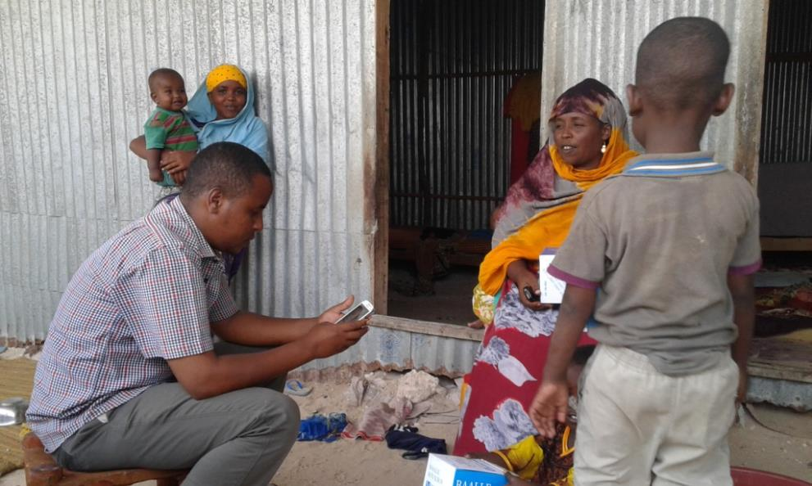
9.2 Appendix > Research components > Quantitative data collection
8.2 Research components
1,796 respondents were successfully interviewed during the quantitative data collection, completed in December 2016.
1,796 respondents were successfully interviewed all over the country
Quantitative data collection in action.

Slide 52
9.2 Appendix > Research components > Qualitative demand-side data collection
FGDs with SMEs AND MERCHANTS
8.2 Research components
The second data collection module consisted in Focus Group Discussions (FGDs) to understand and contextualize the quantitative data and dive deeper into the target population’s needs and behaviors. The FGDs were organized with different profiles and across zones to collect qualitative insights from various sets of audiences.
Qualitative demand-side research: FGDs
The module aimed to incorporate qualitative insights into the research to fully understand and contextualize the quantitative data and allow researchers to analyze perceptions of mobile money services and unmet needs for other financial services, as well as drivers of behavioral change. Levels of financial literacy were also investigated with a view to identify areas where additional knowledge and awareness input efforts may increase the use of mobile money services.
CHARACTERISTICS OF THE FGDs
FGDs WITH INDIVIDUALS
For further insight into demand, two FGDs were also held with SMEs and merchants. The aim of including businesses was to find out their specific needs and behaviors (e.g. paying suppliers/vendors, paying salaries to employees, receiving payments from customers, etc.), how they use mobile money services for their business transactions as well as their views on the surrounding economic factors cited for starting and/or expanding mobile money operations throughout Somalia.
Interviews took place across the economic zones (South Central, Puntland and Somaliland).
Apart from users and non-users of mobile money services, segments of interest were targeted: IDPs (including some coming back from areas under the control of Al-Shabaab), recent returnees, nomadic populations and women, so as to capture the additional barriers these populations might face and understand their different needs.
Each FGD lasted around two hours and was composed of 6 to 8 participants of similar socio-economic and educational backgrounds to maximize participation. The FGDs were recorded and transcripts were translated into English.
Specific questionnaires were designed for each type of FGDs (e.g. with users, with non-users, with SMEs and merchants etc.). Interview guidelines were developed and the field teams received specific training on how to conduct the interviews. Guidelines considered the dynamics in the different zones in Somalia and Somaliland, as well as the particularities of the segments of interest.

Slide 53
1.2 Introduction > Research components
8.2 Research components
FGDs were organized with different profiles and were distributed purposively, across zones and across urban and rural areas and IDP camps. Visits to mobile money agents and mystery visits were also organized in each zone in January 2017.
Focus Group Discussions
FGDs were conducted by experienced local consultants with the support of discussion guidelines. Each FGD was composed of 7-8 participants of similar socio-economic and educational backgrounds to maximize participation. FGDs were distributed across zones and across urban and rural areas and IDP camps.
Somaliland
Puntland
South Central
Mobile money users
1 in Hargeisa
1 in Mogadishu
Non mobile money users
1 in Gebiley
1 in Sinujiif
Displaced population
1 in Mogadishu, 1 in Baidoa, 1 in Kismayo
Nomads
1 in Dhaboolaq
SMEs/merchants
1 in Hargeisa
1 in Garowe
Women
1 in Libaaxe
1 in Mogadishu
Total
10 FGDs General Public
2 FGDs with SMEs/merchants
Visits to agents and mystery visits
To complement the demand-side quantitative and qualitative data, 9 visits to agents and 18 mystery visits were conducted in Mogadishu, Garowe and Hargeisa.
Different types of mobile money agents were interviewed: operators in the Mobile Network Operators’ branches, and smaller operators (e.g. open street hawkers or grocery stores).
During a mystery visit, the interviewer does not present himself/herself as a data collector. Instead, he/she walks into the shop as a potential customer looking for more information on services. The approach allows the interviewer to observe and evaluate, as any other customer would do, the services on offer and the manner in which they are presented to potential customers.

Slide 54
9.2 Appendix > Research components > Qualitative supply-side data collection
MYSTERY VISITS OF AGENTS
8.2 Research components
The third data collection module consisted in a market survey focusing on the mobile money ecosystem’s supply-side. Information was captured in a multi-dimensional way, via questionnaires, but also using observation methodologies during mystery visits.
Qualitative supply-side research
The last data collection module was a market survey focusing on the mobile money ecosystem’s supply side. The module’s objectives were:
Mapping and documenting the ecosystem: any partnerships between MNOs and MTOs and between MNOs and banks, agent distribution networks, etc.;
Documenting the mobile money services offered: characteristics of the e-wallet, account limits, e-float management, registration criteria, interoperability between operators, links with banking services, etc.;
Understanding the role played by agents and appreciating what would be required for agents to facilitate greater consumer understanding, uptake and use of mobile payments.
Mystery visits of agents were designed as a test of the customer experience. During a mystery visit, the interviewer does not present himself/herself as a researcher. Instead, he/she walks into the shop as a potential customer looking for more information on a variety of services offered. The approach allows the interviewer to observe and evaluate, as any other customer would do, the services available, the manner in which they are presented to potential customers, the quality of service, the shop settings etc. Sampling was purposive. 18 mystery visits of agents were conducted in Mogadishu, Garowe and Hargeisa.
IN-DEPTH INTERVIEWS
FACE-TO-FACE INTERVIEWS WITH AGENTS
Interviews were conducted with sector experts and stakeholders to complement the findings with a higher level of analysis. The research team engaged with the CBS and the MPT of the FGS to create an information-sharing process.
Interviews were conducted with sector experts, MNOs, MTOs, banks. The consultants tried to unveil the key business interests of operators, money transfer businesses, banks and agent networks.
Different types of mobile money agents were interviewed: operators in the Mobile Network Operators’ branches, and smaller operators (e.g. open street hawkers or grocery stores).
Face-to-face interviews relied on a questionnaire of no more than 20-25 questions since agents often have little time to dedicate to such surveys. Sampling was purposive. 9 interviews with agents were conducted in Mogadishu, Garowe and Hargeisa.

Slide 55
Agenda
Agenda
1. Introduction
2. Ecosystem mapping
3. Penetration rates
4. Financial practices
5. Usage patterns of mobile money
6. Perceptions around mobile money
7. Triggers for adoption and barriers to adoption
8. Recommendations
9. Appendix
9.1 Glossary and definition of key terms
9.2 Research components
9.3 Survey sampling design
9.4 Survey dataset: key socio-demographics

Slide 56
9.3 Appendix > Survey sampling design
8.3 Survey Sampling Design
A sample size of 1,540 households was computed to achieve representative results per strata, with a margin of error of +/-3% and a confidence level of 95%.
SAMPLING FRAME
The survey sampling frame was constructed based on two previous surveys implemented in Somalia. The first one is the 2011 UNFPA Population Estimation Survey (PES), which provides population estimates and regions, districts and EAs decomposition. The second is the last round of the World Bank Somalia High Frequency Survey (SHFS).
After initial discussions with the World Bank, it was decided that the sampling frame would be divided between economic zones (South Central, Puntland, and Somaliland), then further broken down between urban areas, rural areas and IDP camps. The stratification allows each type of EA (rural, urban, IDPs) to be represented for each zone.
The sampling frame was purposive in the case of IDPs. Only the IDP camps in Mogadishu, Bossaso, Hargeysa and Kismayo were included in the sampling frame. This was decided so as to have dedicated field teams to survey IDP camps, as this requires additional training and monitoring.
Strata population figures were taken from the PES 2014 population report. For urban strata, districts and EAs counts were approximated using PES EA decomposition. For rural strata, districts and EAs counts were estimated from UNDP settlement and town data. IDP camps were listed using UNHCR IDP camps data.
SAMPLE SIZE CALCULATION
The sample size calculation followed the methodology outlined in the Columbia University survey design courses. It consisted in first calculating the sample size necessary for a simple random sampling procedure corresponding to the desired objectives. The sample size was then multiplied by the design effect for the adopted sampling procedure. This design effect depended on EA size and strata Intra-Cluster Correlation (ICC) values at the EA level. These ICC values were computed using SHFS sources of income answers. The total ICC to strata was imputed where SHFS values where unknown.
The Somalia Mobile Money Survey aimed to measure a penetration measure of mobile money services, that is to say, a proportion. This proportion was expected to be around 39%, following the 2014 Global Findex Database results. It was decided to compute the sample size with:
a confidence level of 95;
a statistical power of 80% (these are standard values);
a margin of error of 3%;
a probable non-response of around 10%.
Size calculations were based on Konstantopoulos’ (2009) optimization model. Using ICC and district and EA fixed cost considerations, sizes are computed to optimize margin of error with respect to costs. 1,540 households was the final sample size.
Notes:
FIX THESE,no titel

Slide 57
SAMPLING DESIGN
8.3 Survey Sampling Design
The design adopted for the survey was a stratified four-stage cluster sample.
Selection Stages
Sampling Strategies
The design adopted for the survey was a stratified four-stage cluster sample.
Primary Sampling Units: Districts
Districts were selected with Probability Proportional to Size (PPS). PPS was adopted to ensure that districts with a higher population have a greater probability of being included within the sample. In each stratum, the number of districts selected is determined proportionally to the strata share of the total sampling frame population. Districts are then randomly selected proportionally to their share of the stratum population. The clustering by district allowed for a reduction in costs.
Secondary Sampling Units: Enumeration Areas
This stage allocation was also based on allocation PPS at the EA level. In all districts, the same number of EAs was selected.
Tertiary Sampling Units: Households
Within the EA, the households were selected following the random walk method.
Last Sampling Units: Respondents
A quasi-probability technique was used for the selection of the respondents within the household to decrease costs. The selection was randomized through a randomization formula within the encoded questionnaire. The randomization took place among the adults above 16 present at the time of the interview.
Strata (all selected)
Region x Type
1st Stage (PPS)
Districts (fixed size)
2nd Stage (PPS)
Enumeration Areas
3rd Stage
(Random walk)
Household
4th Stage
(Randomization tool)
Respondent

Slide 58
9.3 Appendix > Survey sampling design
8.3 Survey Sampling Design
Strict procedures were applied for the random walk.
Random walk method
A. Steps for the random walk
Step 1: The team leader divides the EA into three segments or sub-parts and assigns a segment to each enumerator:
In each segment, a total of 4 interviews are to be conducted;
The enumerators walk the length of the EA as a team, and agree on the boundaries of each segment.
Step 2: The team leader assigns starting points to each team member in each segment. He/she selects the starting points randomly.
Step 3: In each segment, the enumerators go at the starting point they have been assigned to and start walking. As they walk, they count households on their left:
They start at the first structure they encounter;
They only count the households that are within the EA;
To count the households, they knock at every household structure (e.g. compound, building), and ask for the number of households within that structure. In case no-one answers the door, they ask a neighbor to confirm the number of households in the structure.
Step 4: The enumerators must interview every fourth household they encounter:
They select first the 4th household they encounter. Then they start counting from the 5th household to choose the 8th, 12th etc.;
The process needs to be repeated until 4 interviews are conducted in that segment;
When reaching an intersection within the segment, they always take the left;
When reaching the end of the segment, they move in a circle or go back on the other direction and continue counting on their left;
If they go back to the starting point without having completed 4 interviews, they cross to the next two clusters and continue counting, still keeping to the left – within the limits of their segment.
B. Steps for replacing a household
If the enumerators are replacing a household on the first visit or if they are replacing a household for their 4th interview in the segment, then they continue counting from that household and choose the next 4th household;
Otherwise, they go back to the household where the last successful interview was conducted and begin counting from here. They choose the next fourth household.

Slide 59
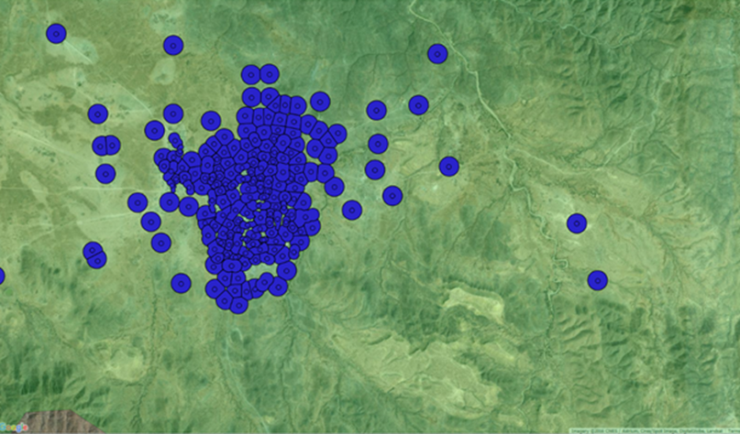
9.3 Appendix > Survey sampling design
CONSTRUCTION OF RURAL EAs
8.3 Survey Sampling Design
Enumeration Areas were constructed for rural areas, based on non-overlapping Voronoi polygons.
PES survey files provided EA structures for urban strata. For the remaining strata, only GPS points/settlements/towns/IDPs lists were available.
For the IDP strata, the sample selection was based on IDP camps specific information obtained from UNHCR.
For the rural strata, since information at the EA level was not present, EAs were constructed from GPS coordinates. The GPS coordinates were in turn obtained from two different sources – UNDP’s 2005 Settlement survey and the 2015 PES survey data for Somaliland and Puntland.
Using the GPS coordinates obtained from these sources, buffers of 250m in radius were drawn. The buffers were created using Voronoi polygons and were defined so as to be non-overlapping. The radius was drawn from SHFS experience and was defined based on the testing of several different sizes and bearing in mind practical considerations.
Dummy buffers for rural EAs

Slide 60
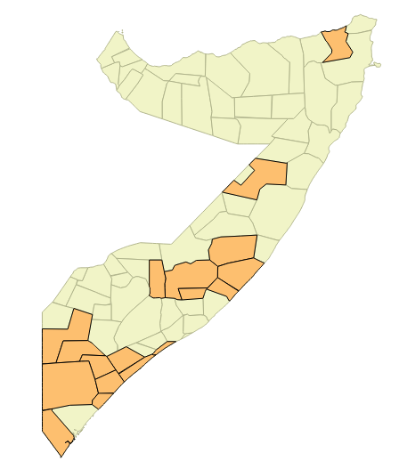
9.3 Appendix > Survey sampling design
8.3 Survey Sampling Design
Inaccessible areas based on security reasons were excluded from the sampling frame.
SAMPLING FRAME CONTEXTUALIZATION
Inaccessible areas were removed from the sampling frame. Such areas included:
Areas under Al-Shabaab medium or strong influence;
Areas where piracy continues to pose a significant threat;
Disputed areas.
Security conditions in Somalia are quite volatile and were worsened with the electoral process, exacerbating clan and sub-clan tensions and raising a surge of political assassinations. Al-Shabaab had also formally expressed its opposition to the elections, and had renewed its threats to target government officials and prominent non-governmental figures participating in the electoral process.
Notably, parts of the following districts were removed from the sampling frame:
In Mogadishu, parts of Heliwaah, Daynile, Kaxda and Yaqshid;
In Jubbaland, parts of Middle Juba;
In South-West, parts of Bay and Bakool, in particular Tayeglow, seized by Al-Shabaab in October 2016, after Ethiopian troops withdrew;
In Puntland, Qandala district, seized by the Islamic State in December 2016;
In Puntland, Galkayo, where Puntland and Galmudug states are regularly clashing.
In orange districts that have been entirely removed from the sampling frame for security reasons

Slide 61
9.3 Appendix > Survey sampling design
8.3 Survey Sampling Design
EAs had also to be replaced, before the survey or during for survey, because there were not accessible, inhabited or eligible. The calculation of the sampling weights included post-weighting adjustments to balance the sample along key demographics and correct for the oversampling.
REPLACEMENT EAs
Replacement EAs were systematically drawn for each strata, following the same methodology as for the selected EAs. If EAs needed to be replaced, replacements EAs were taken within the same strata. There were two types of replacements:
Pre-survey replacements, owing mainly to two reasons: when after a more granular analysis of the security conditions at the EA level, some EAs were deemed inaccessible and unsafe; or when after scrutiny of the maps of the selected EAs, some were found inhabited (cases of settlements that have been abandoned, especially in drone-prone areas).
Post-survey replacements, occurring for a variety of reasons, including the fact that some EAs laid down on markets or business centers not inhabited by households.
CALCULATION OF SAMPLING WEIGHTS
The database has been cleaned and post-weighted after the data collection. The calculations were conducted on Stata.
The sampling weights, i.e. the reciprocals of the sampling fraction employed in selecting the number of sampled respondents in each district, were calculated based on the most precise data available regarding the number of households in each strata/district/EA (notably using PES estimates).
The research team also used post-weighting adjustments to:
Balance the sample along key demographics to correct for some existing within-household coverage bias (as the resulting sample might be comprised of the ‘most readily available’ persons within the sampled households given the within-household respondent selection method preferred);
Correct for the oversampling, i.e. counter for the additional number of interviews and thereby compensate for the unequal probabilities of selection.
The use of sampling weights ensure (i) that the original sample distribution between the areas is preserved, and (ii) that the additional interviews conducted can be included in the analysis without distorting representativeness.
OVERSAMPLING
Invalid interviews did not count against the final sample size (1,540). The research team decided to oversample. In each EA were not interviewed 10 households, as per the sample size calculations, but 12 households. The rationale was to minimize the need to go back to an EA to redo invalid interviews, for security reasons.
However, in the case a field team did not reach the target of 10 valid interviews per EA, it had to go back and redo additional interviews to meet the target.

Slide 62
Agenda
Agenda
1. Introduction
2. Ecosystem mapping
3. Penetration rates
4. Financial practices
5. Usage patterns of mobile money
6. Perceptions around mobile money
7. Triggers for adoption and barriers to adoption
8. Recommendations
9. Appendix
9.1 Glossary and definition of key terms
9.2 Survey sampling design
9.3 Research components
9.4 Survey dataset: key socio-demographics

Slide 63
9.4 Appendix > Survey dataset: key socio-demographics
8.4 Key Socio Demographics
The entire sample is composed of 57% of urban populations, 31% of rural populations and 12% of IDPs, with 51% of men and 49% of women. This matches the distributions of the PES survey.
Urban, rural and IDP population
Entire sample
Gender
Entire sample
Sample size: 1,796 (entire sample)

Slide 64
9.1 Appendix > Glossary and definition of key terms
8.4 Key Socio Demographics
A composite indicator was constructed to measure respondents’ vulnerability, based on five different variables (housing, drinking water, cooking, toilets, and roof).
Vulnerability index
A vulnerability index was created to provide an overview of the living conditions of the respondents and to measure their vulnerability. It is based on five different variables (housing, drinking water, cooking, toilets, and roof). Each variable lists a range of modalities that are each categorized as either -1 ‘poor’, 0 ‘neutral’ or 1 ‘wealthy’. Due to strong correlations between some of the variables, only three of them were retained to compute the final composite indicator (drinking water, toilets and roof). The points are tallied to provide a final score. The final index scales from -3 (most vulnerable) to 3 (least vulnerable).
HOUSING
Apartment
Shared apartment
Separated house
Shared house
Buush/bas
Cariish (mud hut)
House made of metal sheets
Unoccupied building
COOKING
-1
DRINKING WATER
1
1
Stove burning wood
Stove burning charcoal
Gas stove with cylinder
Multiple plate electric stove
Single plate electric stove
0
0
0
1
1
Piped water into home
Piped water into compound
Public tap
Tubewell/borehole
Protected dug well
Protected spring
Unprotected spring
Rainwater collection
Bottled water
Cart with small tank/drum/donkey
Tanker truck
Surface water
0
0
1
-1
-1
1
0
-1
0
-1
ROOF
Metal sheets
Tiles
Harar
Raar
Wood
Plastic sheet or cloth
Concrete
-1
0
0
-1
1
-1
1
TOILETS
Water closet (flush)
Pit latrine
Public toilet
Open space
0
1
1
0
0
1
-1
-1
-1
-1
1
Questions: What type of house does the respondent live in?; What is the main source of drinking water for the household?; What does your household mainly use for cooking?; What type of toilet does your household use?; What type of material is the roof of the house made of?

Slide 65
9.4 Appendix > Survey dataset: key socio-demographics
8.4 Key Socio Demographics
37% of the sample are aged between 16 and 25 years old. 30% of the sample can be considered as vulnerable.
Age
Entire sample
Vulnerability index
Entire sample
29.6% are vulnerable
Sample size: 1,796 (entire sample)
Questions: What is your age?; What type of house does the respondent live in?; What is the main source of drinking water for the household?; What does your household mainly use for cooking?; What type of toilet does your household use?; What type of material is the roof of the house made of?

Slide 66
9.4 Appendix > Survey dataset: key socio-demographics
8.4 Key Socio Demographics
25% of the sample have not received any education. 31% don’t know how to read and 69% cannot speak English.
Education
Entire sample
Literacy and English speaking
Entire sample
Sample size: 1,796 (entire sample)
Questions: What is your highest level of education?; Can you read?; Do you speak English?
0.1% responded ‘don’t know’ or refused to answer for education.

Slide 67
9.4 Appendix > Survey dataset: key socio-demographics
8.4 Key Socio Demographics
53% of the sample are heads of household. Among those who are not, 42% are spouses of the head of household.
Head of household
Entire sample
Relationship to head of household
Focus on non-heads of household
Sample size: 1,796 (entire sample); 817 (non-heads of household)
Questions: Are you the head of your household?; What is your relationship to the head of household?

Slide 68
9.4 Appendix > Survey dataset: key socio-demographics
8.4 Key Socio Demographics
26% of the sample have an average monthly income below 100 USD. Salaried labour, daily labour, small family businesses and remittances from abroad constitute the main sources of income.
Average monthly income
Entire sample
Main income sources
Entire sample
Sample size: 1,796 (entire sample)
Questions: What is your average monthly income?; What are the main source(s) of income for the household?

